Slide 1

Lessons from Global and Country-level Adoption of CORE Group Home-Based Care Guidelines
Bi-Weekly COVID-19 Response Global Coordination Call
August 14, 2020

Slide 2

Agenda 10:00 – 11:30 am EDT
This call will present and discuss the CORE Group Guidelines
for Home-Based Care (HBC).
The HBC Task Force Co-Chairs will provide an overview of the work of the CORE Group HBC Task Force, including a brief presentation of the Guidelines.
Two case studies: one global and one country level will share how the guidelines are being used, including scale up to reach expanded audiences.
Country-level representatives will join the discussion of current issues and future needs.

Slide 3
Guest Speakers and Case Study Presenters
CORE Group Home-Based Care Task Force Co-Chairs
Barbara Muffoletto, Program Manager, of Curamericas Global, and Nicole Grable, Social and Behavior Change Consultant, COVID-19 Technical Response Unit, Mercy Corps will provide a presentation of HBC Task Force Work, including an overall framing of the issue of HBC.
Case #1: “Community and Facility-based Provider Training or Discharge Accompaniment” presented by Rumbidzai Chimukangara, Health Promotion Manager and Risk Communication and Community Engagement Pillar, COVID-19 Response, Zimbabwe Ministry of Health and Child Care.
Case #2: “Digital Tools for Containment, Mitigation, Support and Recovery Efforts” based on CORE Group Home-Based Care Guidelines presented by Helen Olsen, Impact Manager, Medic Mobile.

Slide 4
Guest Speakers and Case Study Presenters
Guest Speakers for RoundTable Discussion
Roundtable Discussion Guest Opening Remarks:
  Anne Ngunjiri, Senior Technical Advisor Gender Based Violence and Violence Against Children (GBV/VAC), LVCT Health Kenya will discuss practical application of SGBV program planning in times of COVID-19.
  Florence Amadi, Senior Technical Advisor Health and Nutrition, Food for the Hungry will discuss Care group module for COVID-19 using the CORE Group home-based care reference guide content in DRC/ Rwanda/ Kenya/ Cambodia.
With additional inputs during Q&A from:
  Brian Nachipo, Advocacy and Communications Officer, Zimbabwe Ministry of Health and Child Care
  Linet Okoth Senior Technical Advisor Community Health, LVCT Health

Slide 5

Let us know what you think!
Polling question #1: What continent are you joining us from?
  Asia
  Africa
  North America
  Europe
  Australia/Oceania
  Antarctica
  Latin America
Select the polling option at the bottom of your screen to respond.

Slide 6
Let us know what you think!
Polling question #2:
How much do you know about COVID-19 prevention and home-based care?
On a scale of 1-5 (1= Very little, 5= A lot!)
  Select the polling option at the bottom of your screen to respond.

Slide 7

Home-Based Care Reference Guide for
COVID-19
References: see reference guide, Icons: thenounproject.com
Notes:
Review slides with multiple icons – too big

Slide 8

The CORE Group Home-Based Care Task Force
8
Notes:
12 CORE Group member organizations

Slide 9
Thank you
Purpose
Reliable, up-to-date information
Material for health promotion activities and materials
9

Slide 10
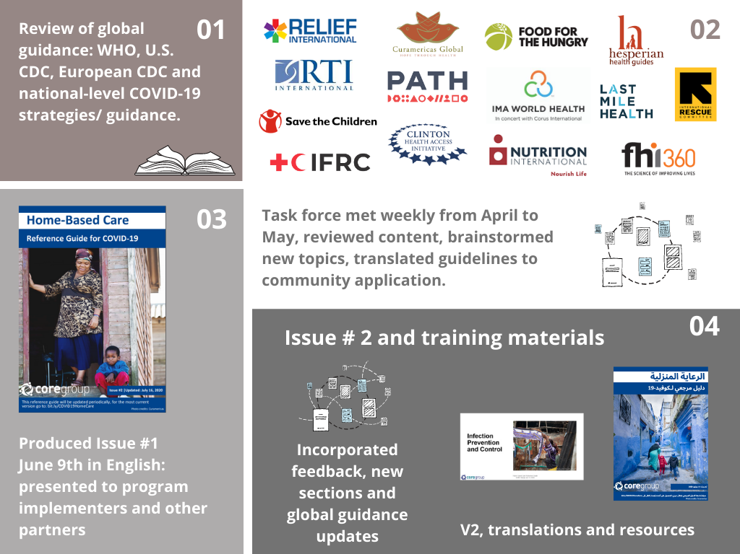
Thank you
Process
10

Slide 11







Topics Include
Symptoms & danger signs
The role of the caregiver
Room setup / home isolation
How to support a person whose condition warrants home care
Ending home isolation
How to prevent the spread of COVID-19 in the home
Handwashing
Face masks
Cleaning & sanitation
How to provide support to family members during COVID-19
Emotional support
Care & essential services
Food security/ nutrition
11
Notes:
** ADD IN ILLUSTRATIVE EXAMPLES OF KEY MESSAGES OR SUB-TOPICS**
How to support a person whose condition warrants home care
Symptoms
– including actions needed for those who present mild symptoms but who are over age 60 or have an underlying condition
Definitions of a suspect case, probable case and contact
Role of Caregiver
Nutritional support and management of non-severe cases
Room isolation and set up
When home space is limited as many homes in areas we work with may not have option of separate bedroom
How to prevent the spread of COVID-19 in the home
Standard prevention methods we all hear about
Details on how to make own materials for sanitation, conduct handwashing in water constrained environments, and how to make own facemasks
How to provide support to family members during COVID-19
Care and essential services
Breastfeeding and nutrition during child illness
Recommendations around care seeking and essential services (ANC, HFD, etc) during COVID
Emotional support
Helping adults and children cope with extra stress
Includes information on domestic violence and sexual assault
Nutritional needs for healthy families during COVID as well as food safety practices
The role of the caregiver -

Slide 12
Let us know what you think!
Use the Chatbox during the presentations to ask questions and share your thoughts.
  Polling question #3:
  What other topics would you like to see included in the home-based care guide?
  Please type your response in the Chatbox!

Slide 13

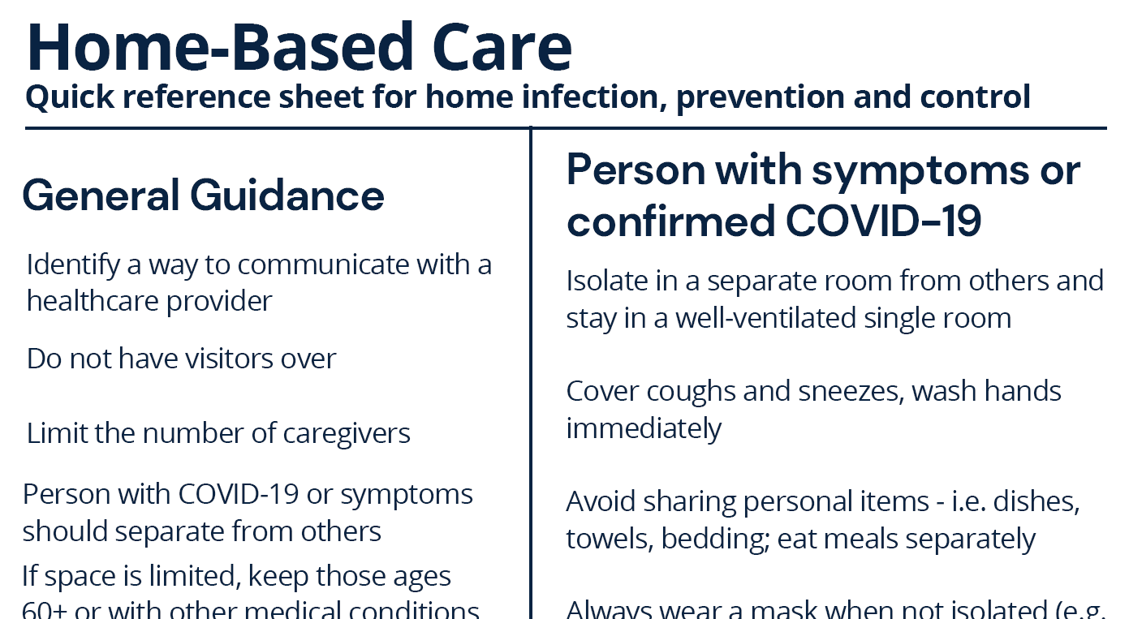
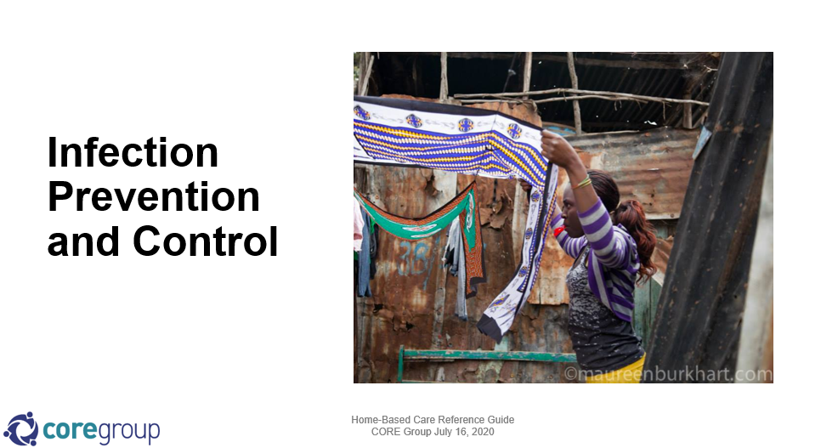
Materials & Resources Available
English
Arabic
Khmer
Quick Reference Guide
Portuguese
French (soon!)
Spanish (soon!)
PowerPoint with key messages
13

Slide 14




Where the guide is being used
IFRC 192 national offices, COVID help desk, internal and external use
Curamericas Global Kenya
Africa CDC
Food for the Hungry in Cambodia / Kenya / Rwanda / DRC
Mercy Corps Health and Safety webinar
Relief International Global Food Security Cluster meeting
PATH field teams
Medic mobile and Dimagi digital app
GAVI CSO Network
Pangaea Zimbabwe Aids Trust
Hesperian Health Guides
14

Slide 15


Goal: Inform and strengthen the capacity of communities to improve their knowledge on the Coronavirus disease (COVID-19)
  Identify reliable sources of information on Coronavirus
  Explain the importance of adopting prevention practices, such as hand washing, use of mask, etc.
  Identify what to do if they have Coronavirus signs or symptoms, including home-based care
  Practice persuading a sick person to seek care quickly when danger signs appear

Slide 16

Lesson 3: Prevention – What can you do?
  Game
  Story
  Current practices
  Prevention through hand washing
  Role play activity: Visiting a friend during a coronavirus outbreak
  Discuss barriers to doing the desired behavior
  Practice and coaching in pairs
  Request commitments

Slide 17

Thank you
More resources and languages available at:
https://coregroup.org/home-based-care-reference-guide-for-covid-19
Rumbidzai Chimukangara,
Health Promotion Manager
Risk Communication and Community Engagement Pillar COVID-19 Response
Ministry of Health and Child Care, Zimbabwe
17

Slide 18
Zimbabwe’s National COVID-19 Response
9 Pillars
Notes:
So, I’ll tell you a bit about our response, this program and then how we used the home-based care reference guide for content within our trainings.
We use this home-based care guide as the foundation of our home-based care section of our training because the scope of the guide compliments our national response which is rooted in 9 pillars

Slide 19
Training Participants
Notes:
Combine the groups when they cover risk communication and IPC
8 major hospitals
15-20 community members
120 community health workers

Slide 20
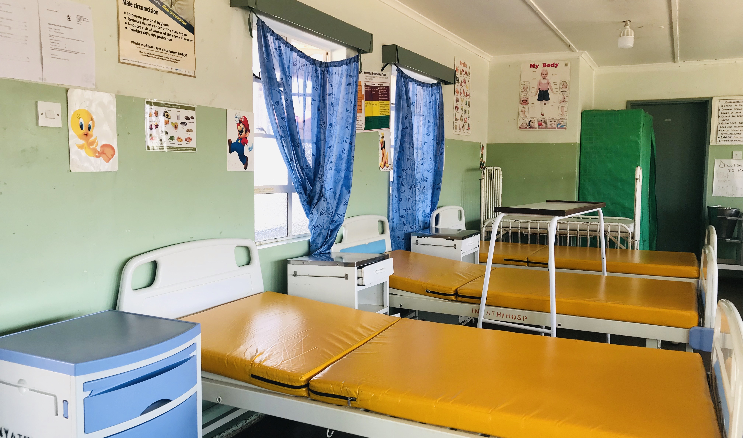
Facility-based team: setting up the facility
Management and coordination
Creates a COVID-19 response team that includes community representatives
Ensures compliance of key pathways
  Screen people at the entrance
  Separating suspects from everyone else
  Set up testing / screening
  Mobilizing resources, PPE, supplies (e.g. drugs and oxygen)
Monitors based on MoH self assessment – triage, availability, staffing
Notes:
For example after the training that covers the 9 pillars; the facility-based team prepares the facility for more covid cases or the 1st case if they have never had the covid case.

Slide 21
Facility-based teams: home-based care
Providers seek information on these topics to provide guidance to community members and upon discharge from the clinic.
Notes:
Used the guide to strengthen the training package
Questions that are often asked and answered in the HBC guide
How to do isolation at the household level?
Who is a ‘contact’ and then what?
What types of masks are ok?
How do communities coordinate nutritious foods for those in quarantine?
What are the strategies for people who need emotional support?

Slide 22
Community
Health
Workers
Focus
Notes:
CHWs can interlink COVID to existing essential services
Screen for COVID while providing services for diarrhea, malaria testing, etc.
Report COVID-related activities accurately across response pillars
Communities are more alert and notify authorities of potential cases

Slide 23
Community Health Workers
Notes:
Communicate with fellow community members – what it is, transmission, etc.
Information is simplified and easy to digest manner
Provides basic information that CHWs can use easily communicate at the community level
Infection, prevention and control
Practical guide to prevent infection at community and household level depending on the types of homes in the country/communities
i.e. handwashing when water is a challenge
Isolation in a single room set up; infrastructure constraint
Case management – What we need the CHWs to do – basic monitoring and timely referral for those who are deteriorating
Risks about Covid-19 - Loss of income, Intimate partner violence (IPV), GBV, risk of unintended pregnancies, nutrition, mental health
Role on being alert for imported cases
To disseminate correct information into the community due to infodemic
Identify community leaders and influencers
Use the two-pager to share with communities
Check on members of the community in quarantine – guide has simple information – signs and symptoms; self quarantine and at the earliest signs of deterioration they are to communicate

Slide 24
Notes:
Key Challenges
General health system constrains
Human resources
Shortage of PPE and medicines (including oxygen): training emphasizes on how to work and improve within the prevailing environment. Examples include
How to use whatever is available efficiently and avoid/reduce waste
Handwashing where water is limited
Wash cloth masks
Emphasize on triage appropriate care is given
Lessons learned
We need a strong community/facility linkage – strengthening the facility only isn’t the only solution
If cases are mild, they are in the community still
We need strong linkages - for that to work we need to build capacity on both ends
We need the information simplified for the targeted audience
Take-a-way materials are necessary, the training alone is 1.5 days, so they need reference materials – i.e. two pager

Slide 25




Creating a Reference Application for Home-Based Care During COVID-19
A case study from Dimagi and Medic Mobile’s FLW partnership
Helen Olsen
Impact Manager
Medic Mobile
Notes:
Presented by Helen Olsen, Impact Manager, on behalf of the Dimagi-Medic Mobile FLW partnership

Slide 26

Background
Over the last decade, substantial progress made on digital health tools for LMICs.
One of the most proven and scalable approaches has been equipping community health workers (CHWs) and other frontline workers (FLWs) with open source, mobile apps.
Medic Mobile and Dimagi develop and help deploy the two most widely used platforms for equipping FLWs with mobile apps.
In March and April 2020, both organizations rapidly shifted into emergency mode to build digital apps for COVID-19 response.
Since May, with support from the Rockefeller Foundation, we have been working together for the first time to align, improve, and share our digital apps.

Slide 27




Significance of Partnership
Among FLWs in lower-income settings who use a mobile app at work, a majority use one of our platforms. Taken together, the scale of our work affords unique opportunities to establish new standards and shape the digital health ecosystem.
Combined scale
Prior to the Rockefeller grant, our organizations had not undertaken a single collaborative project. Our platforms, the CHT & CommCare, are widely seen as technical alternatives. Identifying opportunities for impactful collaboration is thus deeply complex, technically and organizationally.
Unprecedented collaboration
The fast pace of COVID-19 response adds another layer of complexity to this partnership, yet it has also thrown the value of collaboration into sharp relief.
Urgency of need
The outputs of this unique partnership have potential to rapidly become de facto standards and to support the continued growth of a vibrant digital health ecosystem.
Standard-setting

Slide 28
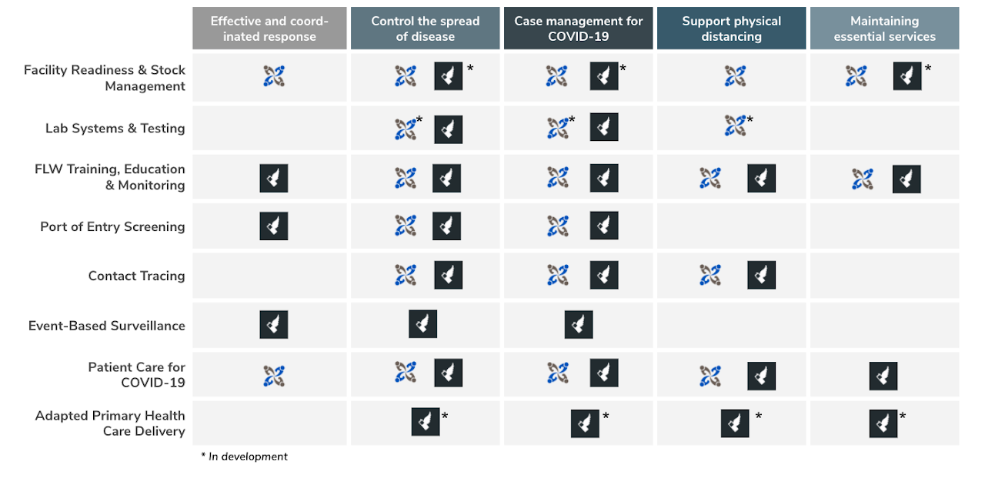
A Shared Conceptual Framework
Opportunity for Home-Based Care
Notes:
Add in visual of our shared conceptual framework, highlight need for home-based care - both for direct and indirect effects of COVID

Slide 29

Collaboration on Apps for FLWs during COVID
A key component of our work together has been curating a suite of COVID-19 response applications and highlighting opportunities for shared design
Home-Based Care was a clear opportunity to create a shared design for an app enabled by the global reach of CommCare and CHT
Our team of Dimagi and Medic Mobile staff opted to use the CORE Group’s Home-Based Care Reference Guide as a blueprint for thinking through our design

Slide 30
Using the CORE Reference Guide
The COVID-19 pandemic offers an opportunity to think critically about maintaining existing health services and responding to the direct effects of the pandemic, particularly in communities at the last mile.
Our teams have joined together to design an application to support home-based care during COVID-19 with an initial focus on direct effects of COVID-19. The CORE reference guide provided a clear template for thinking about the paired need for care provision workflows + supportive education.
This application is designed to provide education, training, and ongoing support for care provision to facilitate home-based care, as well as communication between FLWs, households, and individual patients.
Notes:
Medic Mobile and Dimagi have teamed-up to design a community health application to support Home-Based care for COVID-19. This application will be designed to provide relevant education, training, and asynchronous communication links to CHWs, patients and family/community members to facilitate home-based care. Specific app functionality will include:
Screening of individuals for symptoms of COVID-19
Verification of whether a patient’s residential setting is suitable for providing care, informed by an assessment of the safety of their home environment
Assessment of whether the patient and the family/community members are capable of adhering to the precautions recommended as part of home care isolation (e.g., hand hygiene, respiratory hygiene, environmental cleaning, limitations on movement around or from the house, etc)
Recording of symptom progression, and if needed, facilitate referral to more formal health settings
Providing educational content to CHWs, patients, and family/community members on best practices for providing at-home care

Slide 31
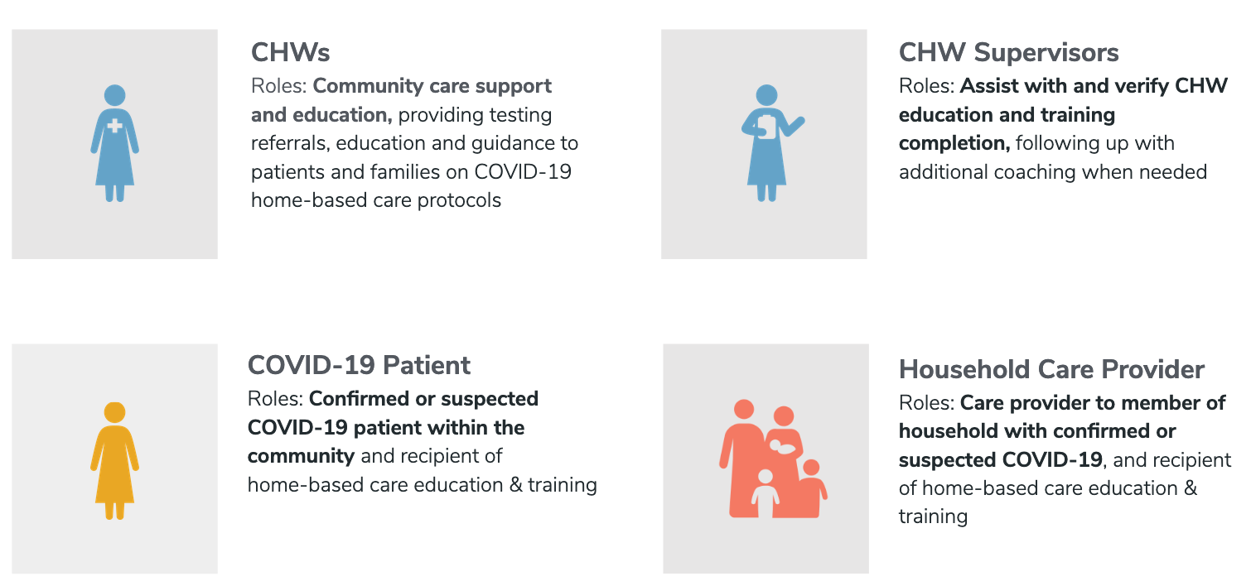
A Shared Design for Home-Based Care
A key component of our work together has been curating a suite of COVID-19 response applications and highlighting opportunities for shared design
Home-Based Care was a clear opportunity to create a shared design for an app enabled by the global reach of CommCare and CHT
Our team of Dimagi and Medic Mobile staff opted to use the CORE Group’s Home-Based Care Reference Guide as a blueprint for thinking through our design
Notes:
Workflow Design
The Home-Based Care (HBC) workflow has two possible points of entry: when a CHW screens a patient and finds that they are showing symptoms of COVID-19 or when a patient receives a COVID-19 lab diagnosis but is not admitted into the facility for care. The workflow visualized below details the steps that follow from the verification of eligibility of home-based care to follow-up and through wrap-up of care.
While this workflow is specific to COVID-19, there are opportunities to use a similar approach and design to a broader range of conditions eligible for home-based care. The design is intentionally flexible in nature and can be included as a component of a broader routine care assessment or as a COVID-19 specific workflow.
Educational Content
Across both CommCare and the Community Health Toolkit, we have developed educational content focused on the needs of CHWs during the COVID-19 pandemic, including modules that are specific to home-based care.

Slide 32
A Shared Design for Home-Based Care
Care Provision Workflow
Patient Symptom Screening
Home-Based Care Assessment
Home-Based Care Follow-Ups
Facility Referrals & Follow-Ups, as needed given MoH and program referral protocols
Educational Modules
Introduction to COVID-19
Introduction to Home-Based Care
FLW Home-Based Care Education, use case specific
Caretaker Preparedness Education, use case specific
Notes:
Medic Mobile and Dimagi have teamed-up to design a community health application to support Home-Based care for COVID-19. This application will be designed to provide relevant education, training, and asynchronous communication links to CHWs, patients and family/community members to facilitate home-based care. Specific app functionality will include:
Screening of individuals for symptoms of COVID-19
Verification of whether a patient’s residential setting is suitable for providing care, informed by an assessment of the safety of their home environment
Assessment of whether the patient and the family/community members are capable of adhering to the precautions recommended as part of home care isolation (e.g., hand hygiene, respiratory hygiene, environmental cleaning, limitations on movement around or from the house, etc)
Recording of symptom progression, and if needed, facilitate referral to more formal health settings
Providing educational content to CHWs, patients, and family/community members on best practices for providing at-home care

Slide 33
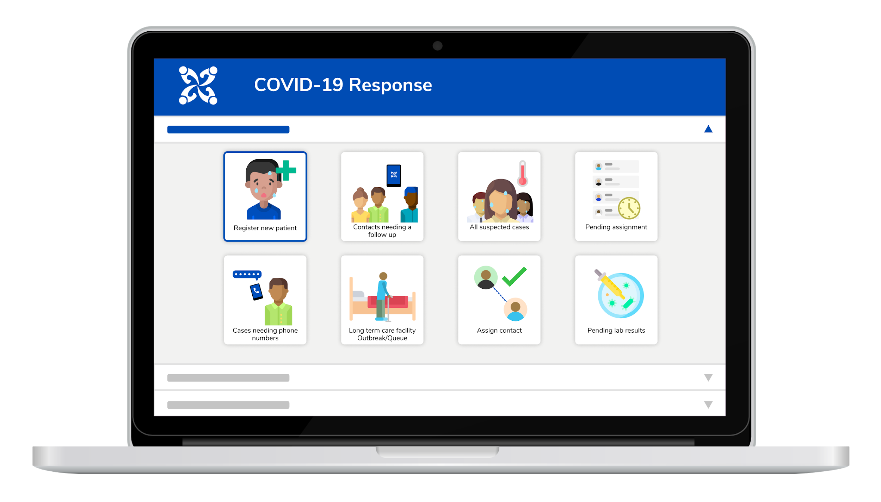
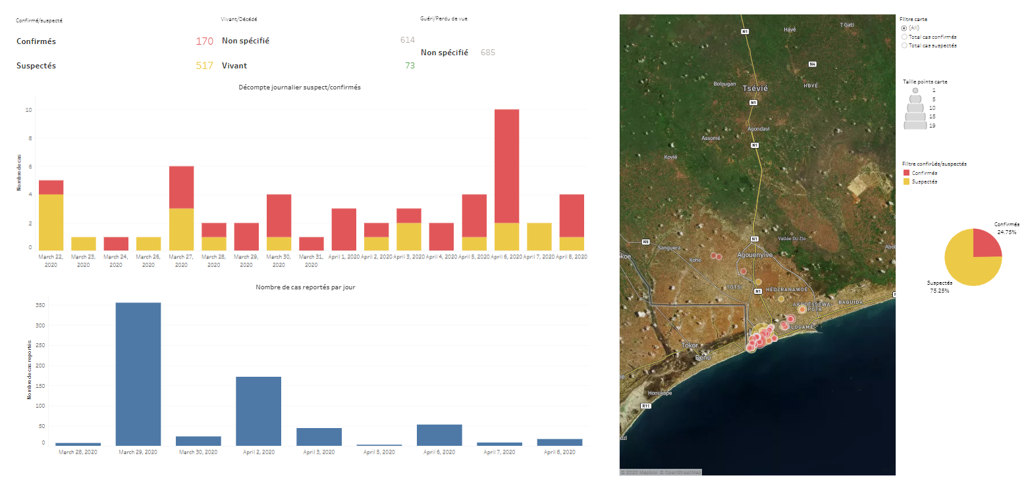
Aligning Monitoring for Home-Based Care
Creating shared monitoring framework across CHT and CommCare to capture process and outcome indicators for home-based care, as well as dashboard visualizations.
CHW training & engagement
Educational modules
Care provision modules
  Symptom screening
  Home-based care assessment
  Enrollment and follow-ups
Example dashboard from Dimagi →
Notes:
An example

Slide 34
Extending Beyond COVID-19 Use Case
We believe that the app design and considerations for home-based care extend beyond COVID-19 to a post-pandemic context with a focus on how best to support FLWs and strengthen health systems.
In the immediate future, the home-based care reference guide offers an opportunity to think about adapting digital workflows for primary health care to provide home-based care for essential health services.
Our goal is to use our shared conceptual framework, as well as learn from our organizational experience delivering primary care and monitoring delivery during the pandemic to respond effectively and with a sense of urgency to drive adaptations to care - and center home-based care options where appropriate.
Notes:
This workflow includes the patient, their household care provider (could also be a community member), CHWs, and CHW supervisors. In addition, it is likely that program staff will engage with CHWs and CHW supervisors to ensure proper training and protective equipment is received. In this design, the primary users of the app are the CHW and CHW supervisors with patients and household care providers as recipients of care and educational content.

Slide 35
Thank you

Slide 36
Let us know what you think!
Polling question #4:
Of the items listed below, what is your project’s greatest need in order to better address COVID-19 in the communities you serve?
  COVID-19 materials in local languages
  COVID-19 facilitation guides and training manuals
  Flyers, banners and other promotional materials
  Access to technical guidance on COVID-19
  Select the polling option at the bottom of your screen to respond.

Slide 37




Discussion
Rumbidzai Chimukangara
Ministry of Health
and Child Care
Zimbabwe
Anne Ngunjiri
LVCT Health
Kenya
Helen Olsen
Medic Mobile
Florence Amadi
Food for
the Hungry
Barbara Muffoletto
Curamericas Global
Nicole Grable
Mercy Corps

Slide 38
Let us know what you think!
Use the Chatbox during the presentations to ask questions and share your thoughts.
  Polling Question #5:
  What is something you learned or a new idea you are taking away from today?
  Please type your response in the Chatbox!

Slide 39
Closure
Visit our website COVID-19 Global Pandemic Response page to learn more about CORE Group and Member Programs and Resources.
https://coregroup.org/resources/2019-novel-coronavirus-global-response-coordination/
You can also upload COVID-specific resources there.
Thank you for your active participation!

