Slide 1
Challenges and Opportunities for Digital Health during COVID-19
Bi-Weekly COVID-19 Response Global Coordination Call
June 12, 2020

Slide 2
Agenda -- 10:00 – 11:30 am EDT
10:00 – 10:05: Welcome, Agenda, Introduce Presenters: Julie Dargis, Senior Advisor, COVID-19 Response, CORE Group
10:05 – 10:15: Opening Comments by Moderator: Steve Ollis, Senior Digital Health Advisor, JSI
10:15– 10:45 Part I: Challenges and Creative Solutions for Quality of Care.
Featured Speaker: Jeanne Koepsell, Community Case Management Advisor, SCF
10:45 – 10:50 Pause for Discussion
10:50 – 11:20: Part II: Mitigation Strategies for Service Disruption
Featured Speaker: Darlene Irby, Director of Digital Health and Health Information, Jhpiego
11:20 – 11:30: Pause for Discussion
11:30: Closure

Slide 3
Presenters
Moderator: Steve Ollis, Senior Digital Health Advisor, JSI.
Facilitators and Thought Leaders: Co-Chairs of the Child Health Task Force’s Digital Health and Innovations Sub-group.
Darlene Irby, Director of Digital Health and Health Information at Jhpiego also serves as the Interim Senior Director of Data Science, Learning at Impact. In addition, Darlene is the Senior Digital Health Advisor for MOMENTUM 2A.
Jeanne Koepsell, Save the Children’s Community Case Management Advisor is the point person for digital health and innovations and is currently the point person for Save the Children’s COVID-19 response. She was instrumental in designing Save the Children’s digital health and innovations strategies, and has provided technical support for SC’s connected health projects as co-founder of SCI’s Connected Health Strategy Group. Jeanne has been on the advisory council of the Global Digital Health Network since its inception.

Slide 4
The Objectives of the Call
The co-chairs of the Digital Health & Innovations Subgroup will focus on quality of care and service disruption during COVID-19,including:
Determining how to ensure an optimal level of quality of care during COVID-19 by incorporating digital methodologies into the health system for both short and long-term.
Presenting challenges to quality of care, including responses to those challenges.
Identifying how to ensure that quality of service remains high, even as opportunities for supervision and other in-person connection with the health services are eliminated.
Presenting examples and tools from organizations of service disruption data, and discuss the bottle necks and challenges with service disruption data collection and data quality during COVID-19.
Considering how partners are mitigating the effects of service disruption, using digital health.

Slide 5
Let us know what you think!
Use the Chatbox during the presentations to ask questions and share your thoughts.
What digital health tool or platform do you use most in your COVID-19 response?
Select comments will be Live-Tweeted by the CORE Group team during the webinar!

Slide 6
Quality of care During COVID-19, and beyond

Slide 7
In this session…
Present challenges to quality of care, including responses to those challenges.
Identify how to ensure that quality of service remains high, even as opportunities for supervision and other in-person connection with the health services are eliminated.
Notes:
Note that many of the issues brought up are always issues – we can learn from what we do during Covid to build a stronger, more resilient, health system.
What barriers can be overcome with innovative approaches or technologies. How to work it out:
Think critically – what outcome do you need that you are not currently getting? (Not just the process that should change).
Example: See whether CHWs who assess, classify and treat properly (not just whether training or supervision is effective)
Think formally (primary research as needed) –
What is causing you not to reach the outcome?
What process(es) could get you to the outcome?
Think creatively – don’t limit yourself to what has been done before.
How can you make the process(es) work?
What piece of the process (if any) could be improved using technology?

Slide 8
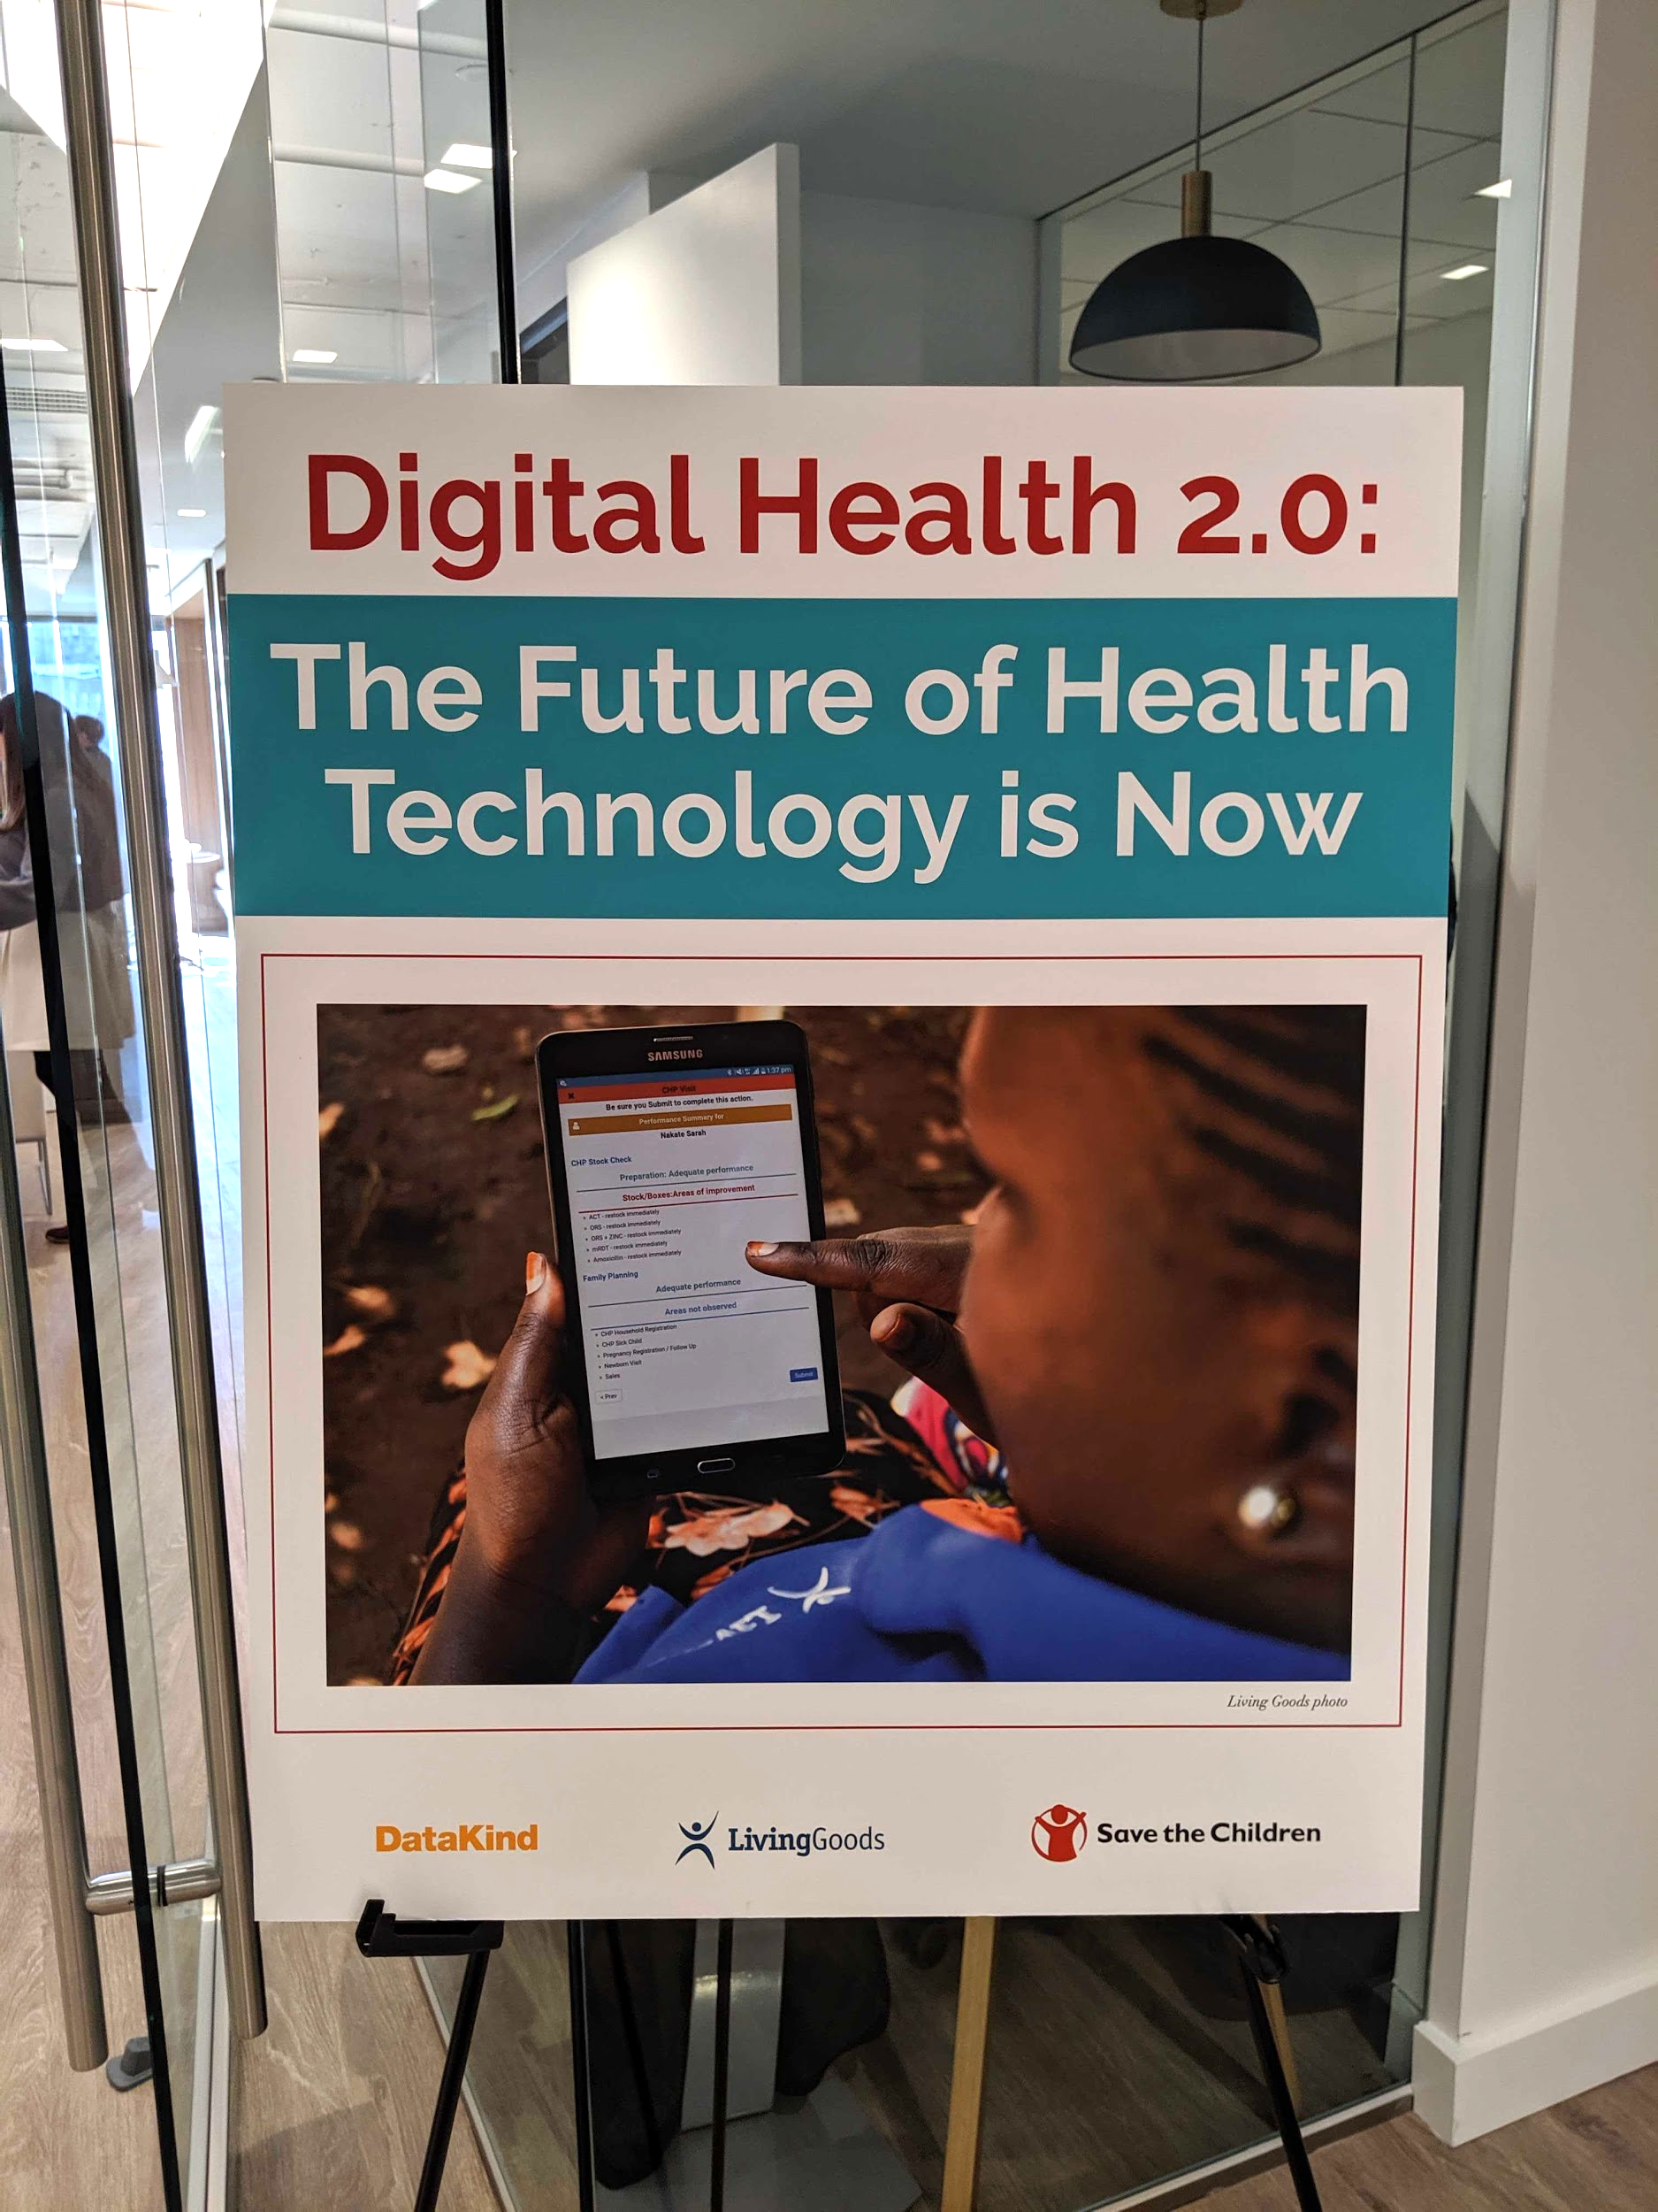
Where we are in digital health
No longer just a tool.
Crucial, but not yet perfect:
Interoperability
Siloed technology solutions
Data confidence
A gap between creators and users
Gaps in accessibility - inequalities.
Notes:
Just a few years ago, we had to fight to use digital health…
Now, digital health tools are transforming how primary health care services are delivered around the world. We’ve seen a recent explosion of innovations aimed at helping those who remain disconnected from the formal health system. This growth is especially apparent in the field of community health as experts and implementers work to find ways to maximize resources to improve health outcomes of communities at the last mile. Community health workers (CHWs) equipped with digital tools are a valuable lifeline between health facilities and communities in need of care. As the only form of organized healthcare for millions, CHWs are a lifeline that has only become more critical with the spread of COVID-19.
However, digital health tools aren’t a silver bullet for emergent COVID response nor long-term health services delivery to underserved communities. Challenges still exist.
At the end of last year, our three organizations (DataKind, Living Goods, and Save the Children) brought together decision-makers, thought leaders, implementers, and technocrats within the field of community health to discuss these challenges and the way forward. The goals of the summit were to identify both existing and new sources of field worker data and its impactful mobilization, and to foster buy-in across the CHW ecosystem to adopt and implement new digital analytics guidelines to meet the fast-growing population demands.
Through several intense hours of conversations, key issues emerged.
Interoperability between reporting systems within the health system cascade and
an abundance of siloed technology solutions continue to be major roadblocks to digital solutions reaching scale.
Data confidence and the skills to use the collected data continue to be a challenge.
A gap still exists between those creating digital health technologies and those adopting, implementing, and utilizing these tools.

Slide 9
Community-based health care during COVID-19
Continuity of select essential services
Ensure appropriate COVID-19 response
Protect health workers
Notes:
Community-based health care , including CCM
WHO guidance – May 2020
Decision-makers will need to make difficult choices to ensure that COVID-19
and other urgent, ongoing public health problems are addressed while minimizing risks to health workers and
communities.
Basic principles and practical recommendations that support decision-making to:
• ensure the continuity of select essential services that can be delivered safely at the community level;
• leverage and strengthen the community platform as an integral part of primary health care to ensure an
effective COVID-19 response;
• protect health workers and communities through infection prevention and control (IPC) measures.
Part 2 contains sections addressing COVID-19 in the context of different life course phases and highlights
disease-specific considerations for adapting community-level activities.

Slide 10
Quality of care during COVID-19
Some issues related to quality of care
Competing priorities
CCM-specific behaviors
Counting respiratory rates
RDTs
Stock management
Covid-specific behaviors
Knowing currently list of signs / symptoms
Recognizing signs / symptoms
Knowing home treatment versus referral
Data quality
Counseling
Referral gaps
Poll – which of these concerns you the most?
Notes:
Competing priorities
Too much to do
Conflict between curative care / prevention /promotion responsibilities
Conflict between regular CCM work at Covid work
CCM Specific
Correctly count respiratory rates
Correctly do RDTs
stock management
Covid specific
Recognizing signs / symptoms
Know signs / symptoms – constantly changing
Knowing when to treat at home, when to refer
Counseling
Getting beyond IEC
Referral
Don’t go
Doesn’t get recorded

Slide 11
Supervision is NOT the answer
Supervision not happening
Lack of human resources
No time to supervise
Changing staff
No money
No transport
Incentives
Preferential supervision
Notes:
Supervision not happening – even without COVID
Lack of human resources
No time to supervise – worse now
Changing staff - and now, staff getting sick / not risking going out
No money
No transport
Incentives
Preferential supervision
Some people may be supervised more often, because closer, better examples (when the supervision tied to show and tell with higher level supervisors)
Means some may not be supervised regularly.
Digital solutions provide opportunity for supervisor and service provide to engage more frequently. It removes the need for transportation, per diem and TDY for ensuring service continuity at supervisor’s place of work. Allows for on-time, adequate, remote mentorship, since the provider can reach the supervisor(s) at any time.

Slide 12
Barriers to quality and potential digital solutions
Competing priorities
Challenges
Too much to do
No clarity in priorities
Potential solutions
E-learning
E-updates
WhatsApp
Open this file to add your apps
https://docs.google.com/presentation/d/1bDazTUJZvgsIPJ4YT2S_IdWxVh2iXYXQUKAO0gUKzBU/edit#slide=id.p

Slide 13
Barriers to quality and potential digital solutions
CCM specific issues
Challenges
Counting respiratory rates
RDTs
Stock management
Potential solutions
Algorithms
E-learning
Videos for specific skills
Specific devices
Photos
Stock reporting forms
Phone calls
Notes:
Algorithms (IMCI, CCM, newborn care, safe delivery) – randomly ask questions. This would be to test their knowledge and identify gaps. After they are asked the question, the app will provide the correct answer, so that it is appropriately used for clinical decision-making. App would share scores with supervisor and with FLHW.
Prepare short videos on specific skills. When FLHW watches the video enough, and feels proficient, they will be filmed and share the film with the supervisor.
Photos of medicine stock, health facility, lines of people waiting, FLHW giving talks to mothers, or of other activities.
Phone calls to FLHW, community leaders, etc. to follow up on perceived quality of care.
ELearning – Use AI to individualize for FLHW based on baseline knowledge, and what they learn over time (like Duolingo)
Responsive systems – evaluate what you answer and give another question based on that

Slide 14
Barriers to quality and potential digital solutions
Covid specific issues
Challenges
Knowing currently list of signs / symptoms
Recognizing signs / symptoms
Knowing home treatment versus referral
Potential solutions
Updates on home screen
Algorithms
E-learning
Videos for specific skills
Photos
Phone calls
“YELP”-type referrals for private providers
Notes:
Some of these are in CCM category as well
Private providers are often unwilling to leave their site, since they may lose money. E-learning would take less time than an off-site training.
They also do not see a purpose in being trained by MoH. Yelp would serve as an incentive to take the course.

Slide 15
Barriers to quality and potential digital solutions
Poor quality of data / low utilization by front-line workers
Challenges
Data entered multiple times
Data not used locally;
Potential solutions
Algorithms feeding into report
Real time data
Dashboards available to CHWs and higher levels
Notes:
CHWs and health centers - low level dashboards in digital when environment allows
Real-time information to the user without requiring double entry.
Dashboards.
Makes it easier to review the data without extensive math
Color coding or simple graphics make it easier to understand what is going on in the community and make decisions.

Slide 16
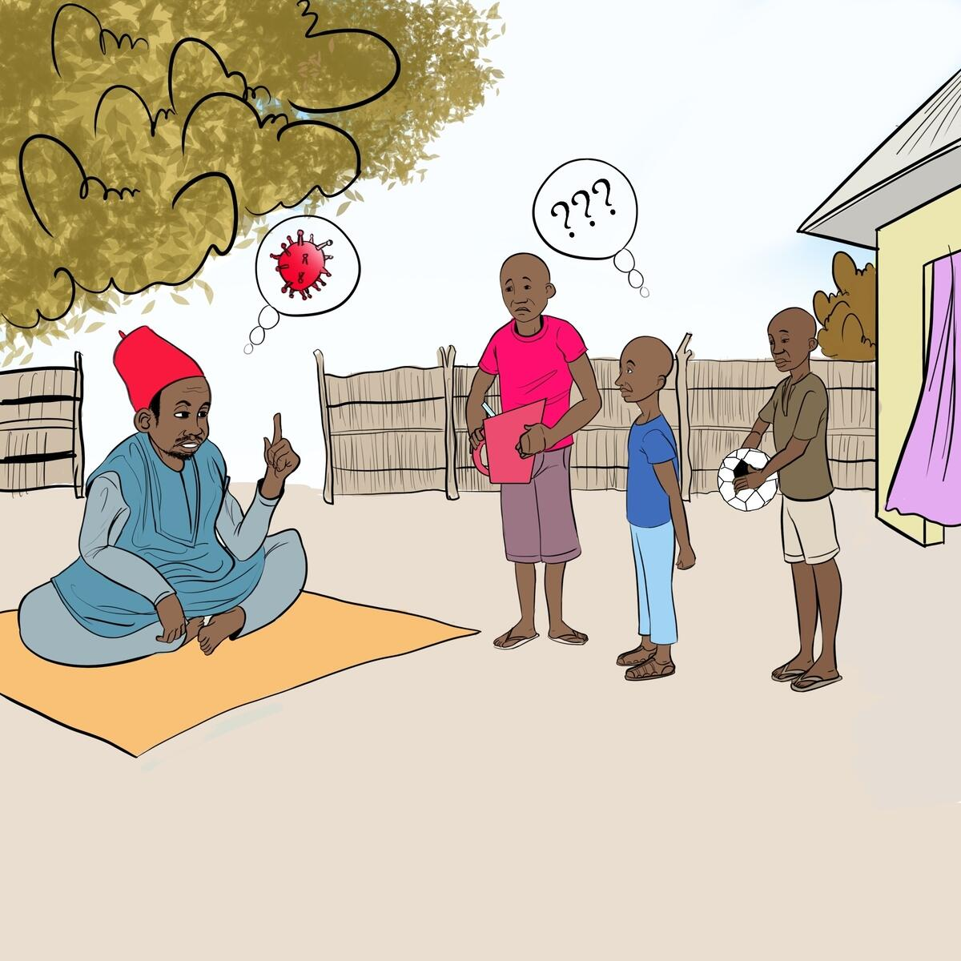
Barriers to quality and potential digital solutions
Counseling
Challenges
Having the correct information
Making it understood
Potential solutions
Videos / flipcharts on phone / tablet
E-learning
SMS

Slide 17
Barriers to quality and potential digital solutions
Referral gaps
Challenges
When to refer
Following up with families
Potential solutions
WhatsApp

Slide 18
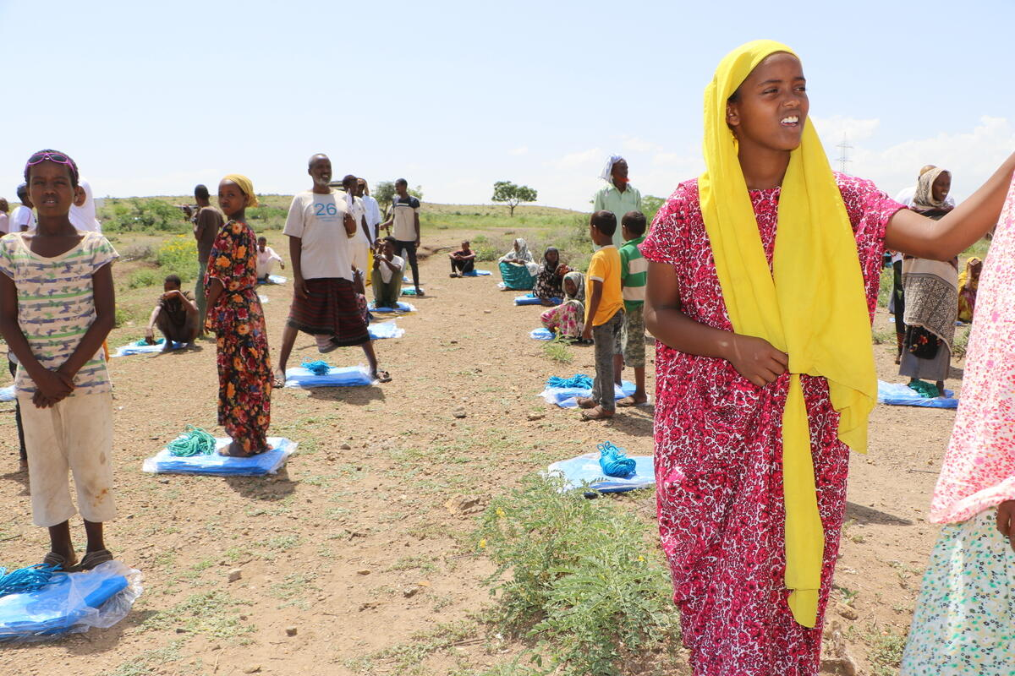
Other alternatives to supervision
Post-service surveys
WhatsApp groups
Notes:
Post-service electronic feedback, by SMS, or android depending upon level – clients provide direct input on amounts paid for services, and quality of services.

Slide 19
Resources
Sub-title goes here
If you HAVE an app, have it included in the UNICEF catalog:
https://www.ungm.org/Public/Notice/108734
WHO, Community-based health care, including outreach and campaigns,in the context of the COVID-19 pandemic, 5 May 2020.
https://www.who.int/publications/i/item/community-based-health-care-including-outreach-and-campaigns-in-the-context-of-the-covid-19-pandemic

Slide 21
Let us know what you think!
Discussion and polling

Slide 22
Mitigation Strategies for Service Disruption
Darlene Irby
Director Digital Health, Jhpiego
Senior Director, Data Science, Learning and Impact (Interim) Jhpiego
Co-chair, Digital Health and Innovations Working Group- CHTF
June 12, 2020

Slide 24
Present examples and tools from organizations of service disruption data Discuss the bottle necks and challenges with service disruption data collection and data quality during COVID 19 Consider how partners are mitigating the effects of service disruption, using digital health
Objectives

Slide 25
Digital tools and platforms in use: assessing COVID 19 service disruption
Modeling of service disruption
Lives Saved Tool (LiST)
Developing and testing hypothetical scenarios of changes in health services provided to population
Global Fund COVID 19 Country Monitoring Tools
Newly launched
National health information systems
Leveraging existing platforms and assessing changes in data

Slide 26
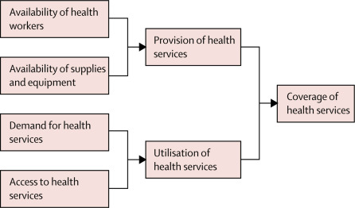
LiST Framework
Develop parameter driven scenarios for coverage of health services
Assess difference in Lives Saved as compared to baseline scenario

Slide 27
Applying LiST to COVID 19 disruption
Question
3 scenarios of varying severity
118 LMICs
Used Lives Saved Tool (LiST)
Modeling approach
If certain hypothetical COVID-19 outbreak and response scenarios were to occur, what would be the indirect impact on maternal and child mortality?
3, 6, 12 month time frames
Engagement from WHO, UNICEF, World Bank, GFF, BMGF
First phase modeling
Model mortality impact of change in 70+ RMNCH interventions and risk factors
Realistic, quantifiable estimates as a reference point for decision makers
Source: Early estimates of the indirect effects of the COVID-19 pandemic on maternal and child mortality in low-income and middle-income countries: a modelling study
Timothy Roberton, DrPH, et al, The Lancet Global Health :2020DOI:https://doi.org/10.1016/S2214-109X(20)30229-1

Slide 28
Modeled impact of service interruption on maternal and child mortality
First scenario
Coverage reductions of 9·8–18·5%
and wasting increase of 10%
Third scenario
Coverage reductions of 39·3–51·9%
and wasting increase of 50%
These deaths would represent a
9·8–44·7% increase in under-5 child deaths per month, and an
8·3–38·6% increase in maternal deaths per month,
across the 118 countries.
LiST analysis shows that if the COVID-19 pandemic results in widespread disruption to health systems and reduced access to food, LMICs can expect to see large increases in maternal and child deaths.
Over 6 months there would be 253 500 additional child deaths and 12 200 additional maternal deaths.
Over 6 months there would be 1 157 000 additional child deaths and 56 700 additional maternal deaths.
Source: Early estimates of the indirect effects of the COVID-19 pandemic on maternal and child mortality in low-income and middle-income countries: a modelling study
Timothy Roberton, DrPH, et al, The Lancet Global Health :2020DOI:https://doi.org/10.1016/S2214-109X(20)30229-1

Slide 29
Global Fund COVID 19 Country Monitoring Tools ( May 2020)
The GF Country COVID -19 monitoring tool has been developed to detect early risk of disruptions to Global Fund supported programs
The tool is not meant to be a rigorous monitoring system; due to the challenging situation, data is not validated or cross-checked
The tool is administered to all Local Fund Agents (LFAs) through an on-line survey platform. The(LFAs collect information through interviews with in-country stakeholders and CTs
LFAs review and update survey responses every 2 weeks (as and when there are changes in the country situation)
The survey was launched on 24thApril 2020 and the first batch of survey results extracted on 6thMay with a response rate of 100% (survey entries received for 106 countries)

Slide 30
Objectives of the Global Fund COVID 19 Country Monitoring Tool
Serve as an early warning system for the Global Fund to develop actions and to monitor service disruptions/interruptions
Allow the Global Fund to compare trends over time and across countries regions, triangulating sources; with monitoring data from partners and other sources;
Reduce the need for ad -hoc requests for information from country teams
***Caveat: The tool identifies potential risks and disruptions to programs but is not meant be a rigorous :

Slide 31
What is the level of disruption to HIV, TB and Malaria services and in-country systems?
For each disease, almost 25% of countries estimate high or very high impact of service disruption on GF programs;
Six month supply of key products at risk in approx. quarter of countries;
Over 50% of HMIS, LMIS and supply chains are currently experiencing No to Limited disruption;
However half of countries are facing partial to significant disruption to HIV and/or TB lab services
For each disease, almost 25% of countries estimate high or very high impact of service disruption on GF programs;
Six month supply of key products at risk in approx. quarter of countries;
Over 50% of HMIS, LMIS and supply chains are currently experiencing No to Limited disruption;
However half of countries are facing partial to significant disruption to HIV and/or TB lab services.
Source: The Global Fund COVID 19 Country Monitoring Tool May 2020

Slide 32
The Global Fund COVID- 19 Country Monitoring Tool Draft Survey Questions
1. Is there a national COVID-19 response plan in place and is it costed?
2.Has the government implemented any restrictions for travel, meetings or gatherings as a response to COVID-19?
3.Can grant implementing and grantmaking stakeholders communicate, either in person or through remote working technologies, to make decisions?
4.To what extent can the CCM (or equivalent body) still facilitate inclusive engagement with community actors and key populations in Global Fund processes?
5.To what extent is it estimated that service delivery disruptions will affect implementation of Global Fund grant supported activities and achievement of planned results?
6.Have there been any disruptions to HMIS and LMIS reporting?
7.Does the country have an adequate 6-month national stock of key program products?
8.Are there disruptions to the in-country supply chain systems?
9.Are there any disruptions in the existing HIV and/or TB lab services due to COVID-19?
10.Is the CCM (or equivalent body) facing any capacity constraints in relation to the development and submission of the Funding Request (FR)?
11.When are the final Global Fund grant making document(s) expected to be submitted?
12.(Optional) Please provide any other relevant information on potential risks and disruptions to GF related programs not mentioned above or anything else specific tot he grant or national situation.
13.To what degree are LFA services and deliverables impacted by the COVID-19 pandemic?
14.What are the key barriers affecting the timely delivery of LFA services in your country?

Slide 33
Routine Health Information Systems
Reasons to use National HMIS, EMR, National Registries, DHIS2, Facility Assessments to capture COVID 19 disruption
Accessible
Health facilities (and sometimes also districts and other subnational areas) that have established RHIS can gather data quickly through queries.
Can be done remotely.
Possibility to gather data on a large number of facilities and disease areas.
Capacity Gaps
A cadre of staff already have expertise in using RHISs, eliminating need for training or development/creation of a new solution.
Dashboards
Basic visualization functionality makes basic analysis faster.
Source: WHO Guidance for national and district planners and managers: analysis and use of health facility data, January 2019

Slide 34
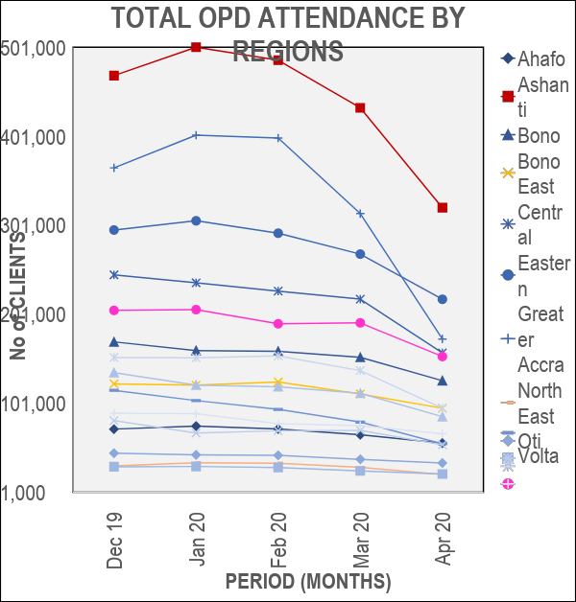
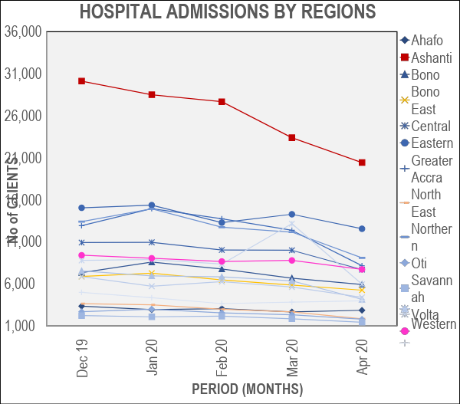
Period December 2019 – April 2020
National DHIS2 example
Period December 2019 – April 2020

Slide 35
Digital tools and platforms: Challenges in collection and quality
Lack of understanding exactly where and who the COVID 19 pandemic will impact most
The types of people affected by the pandemic ( age groups, sex)?
Where are they receiving their services ( age groups, sex)?
What services do they receive?
Rapidly changing pandemic without targeted data collection objectives leaves decision makers with a lot of unknowns to weigh
How and where to target support and resources
Strengthening performance
Focus on equity and access

Slide 36
Service Disruption Indirect Data Implications
Digital tools and platforms: Challenges in capturing indirect service disruption
Demand Side
Supply Side
Stigma, fear, mis- information, lockdowns
Commodities, Stock outs , Health Workforce, paused or diverted services

Slide 37
Digital tools and platforms: supporting mitigating effects of digital health
Applying lessons learned from Ebola
Looking at trends and analysis from routine health information systems
Thinking ahead to address challenges with RHIS
Considering other tools
LiST
DHS
Qualitative/Context Surveys

Slide 38
The Case for Digital Health
Lessons learned from the Ebola Outbreak in 2014, “there was an unclear and asynchronous picture of the disease’s spread - a “fog of information” impeded the response.
Given the importance of information to the response, recommendations focus on data and digital technologies.
Utilize existing digital health information systems at the facility and national levels to monitor the provision and utilization of essential health services and health workforce capacity
Source: Considerations for USAID Mission Staff for Programmatic COVID-19 Preparedness and Response: USAID Digital Response April 2020

Slide 39
Routine Health Information Systems:
Opportunities
Looking at Basic Trends and Analyses can help planners and managers to identify:
whether the occurrence of a disease/health condition is changing over time and whether health service performance is improving over time
the places where particular disease/health conditions occur and where programs or interventions are most or less effective
the types of people affected by health conditions or receiving the services (sex, age groups)
National HMIS, EMR, National Registries, DHIS2, Facility Assessment

Slide 40
An updated national Master Facility List should ideally provide a list of all health facilities (by type and ownership) in the country. RHIS analyses should state clearly which providers are included and should also provide an indication of the number/proportion of facilities (with their ownership) that are not included. Information on the completeness of reporting from RHIS facilities is also essential for interpretation of the data Furthermore, facility data provide information only on those people who use the facilities.
Routine Health Information Systems: key data considerations
National HMIS, EMR, National Registries, DHIS2, Facility Assessment

Slide 41
Data Reliability/ Completeness Health facilities (and sometimes also districts and other subnational areas) often do not have reliable catchment population data and data may be incomplete or not update, may reflect only aggregate data that is updated quarterly. Indicators ( Denominators/Numerators) For indicators that need population denominators, e.g. coverage indicators, it is difficult to produce meaningful information.( In this case, it may be more useful to present numerator trends than to calculate the indicators ) Gaps in data How representative are RHIS data of health services in a country? National RHIS data represent only those facilities that report into the RHIS. In some countries, all health facilities are required to report into the national RHIS. In other countries, only Ministry of Health (MOH) facilities are part of the system. Private Sector Reporting The private sector (including private-for-profit providers, nongovernmental organizations (NGOs) and faith-based organizations) services may not be fully captured in RHIS. Source: WHO Guidance for national and district planners and managers: analysis and use of health facility data, January 2019
Routine Health Information Systems: Challenges

Slide 42
The Demographic Health Surveys (DHS) and Multiple Indicator Cluster Surveys (MICS) s provide more detailed data on the private sector role in family planning methods, antenatal / delivery and postnatal care and childhood treatment services Denominators: Population data serve as the denominator for calculating rates, percentages and coverage. With GIS, can link DHS data with routine health data, health facility locations, local infrastructure such as roads and rivers, and environmental conditions. Can use STATCompiler and other software for deeper analysis
DHS / Population Surveys: Opportunities

Slide 43
Denominators: Obtaining the correct denominator (the target population) for facility indicators that require a population denominator is an ongoing challenge in many settings. Official national population estimates are usually projections based on the last census and the official annual population growth rate. Capacity: Requires some level of expertise and data lift can be a challenge with tracking service statistics over time. Census methodology might not meet international standards provide sufficient subnational population estimates, e.g. for districts; to account for population shits, migration and urbanization. For coverage indicators, denominators based on census population projections often result in coverage rates substantially over 100%, especially at the subnational level
DHS / Population Surveys:
Challenges

Slide 44
Basic Qualitative / Context Surveys: Opportunities
Opportunities
Challenges
Data collection occurs rapidly, because the data points involve surveys and real-time gathering, there are few delays in the collection Results can be analyzed very quickly and there is no real need to separate systems or identify variables It offers reliable and repeatable information Can be anonymous. When looking at sensitive topics , respondents are not required to identify themselves with specificity in the data collected Can be performed the remotely does not require the participants to report to a specific location to collect the data. You can speak with individuals on the phone, conduct surveys online, or use other remote methods
Difficult to verify the validity of the data. Not rigorous and does not provide monitoring

Slide 45
The Importance of Indicators
Specific, relevant, timebound and refer to a core set of indicators that can serve as proxies for monitoring the pandemic’s impact on essential health services.
Prioritized based on the country’s specific context, including the selection of services that are to be maintained or modified and the COVID-19 transmission context.
They are not meant to be exhaustive but are meant to be used to monitor disruptions in essential health services or serve as triggers for implementing modifications toe activities during different phases of the pandemic.
Criteria for selecting the priority indicators included
(a) the availability of data and the ease of data collection and reporting at the community and facility levels,
(b) their coverage of essential services and
(c) If possible , should be drawn from existing indicators that are already measured.).

Slide 47
COVID-19 Featured Resources
Visit our website COVID-19 Global Pandemic Response pages to learn more about Child Health Task Force and CORE Group Resources.
Child Health Task Force Website:
https://www.childhealthtaskforce.org/
Child Health and COVID-19 Resource Page:
https://www.childhealthtaskforce.org/news/2020/understanding-child-health-context-covid-19
CORE Group COVID-19 Resource Page:
https://coregroup.org/resources/covid-19/
You can also upload COVID-specific resources there.

Slide 49
Closure
Thank you for your active participation!

