Slide 1
Afya Halisi Missing Link- Health systems responsiveness towards reproductive health needs of adolescent girls
Carol Ajema
Core Group Conference
14th-16th October 2019
Kenya

Slide 2
Global Picture
How many?
There are approximately 1.2 billion adolescents
They make up 18% of the world’s population
88% of adolescents live in low- and middle-income countries
One in every six people in low-income countries is an adolescent
Adolescents have diverse Sexual and Reproductive Health (SRH) needs
.

Slide 3
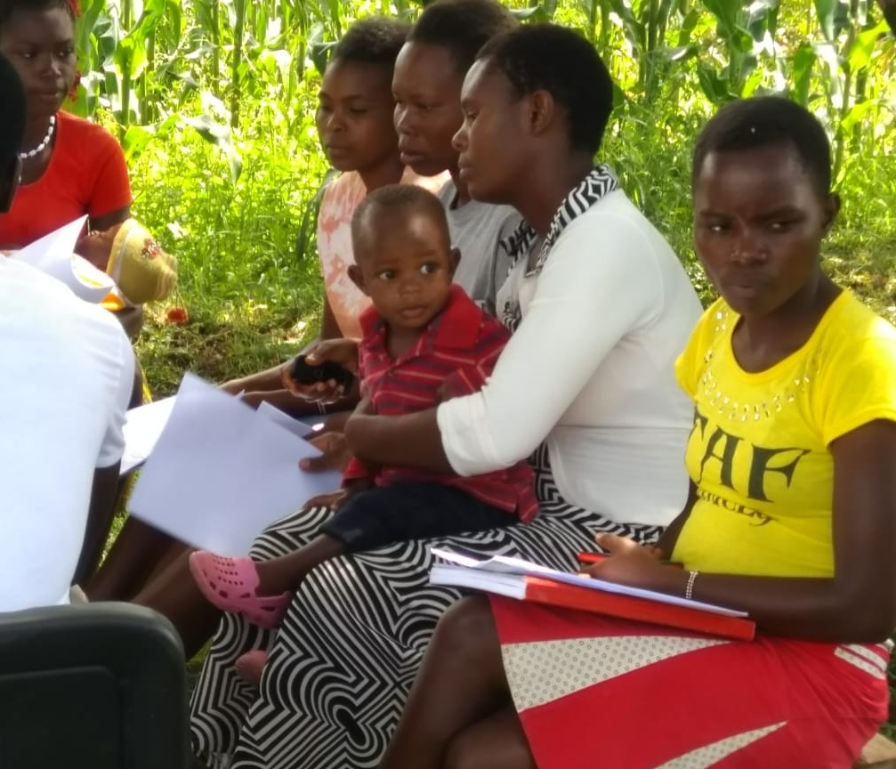
Why adolescents?
In Kenya: 24% are < 20 years of age. Optimum access to health care is hindered by: Socio-cultural practices Negative health provider attitude

Slide 4
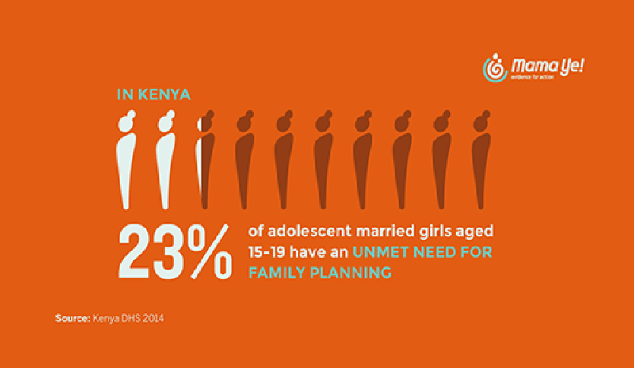
1. Intro
Choose one approach to grab the audience’s attention right from the start: unexpected, emotional, or simple.
Unexpected Highlight what’s new, unusual, or surprising.
Emotional Give people a reason to care.
Simple Provide a simple unifying message for what is to come

Slide 5
Study Aim
To understand how gender norms and cultural practices impact adolescent boys and girls experiences, perceptions and utilization of services, and practice of positive health behaviors; and to assess health care providers’ experiences in the provision of quality and respectful care in Kenya.

Slide 6
Study design and sites
Design
Cross-sectional
Study sites
4 counties
Migori
Kisumu
Kitui
7 sub counties
21 health facilities
Public facilities
Private facilities
Kakamega
FBOs

Slide 7
Health facility assessment report – The Status of AYSRH services (Dec 2017 to Feb 2018)
Facilities offering AYSRH Services( 122/192 facilities)

Slide 8
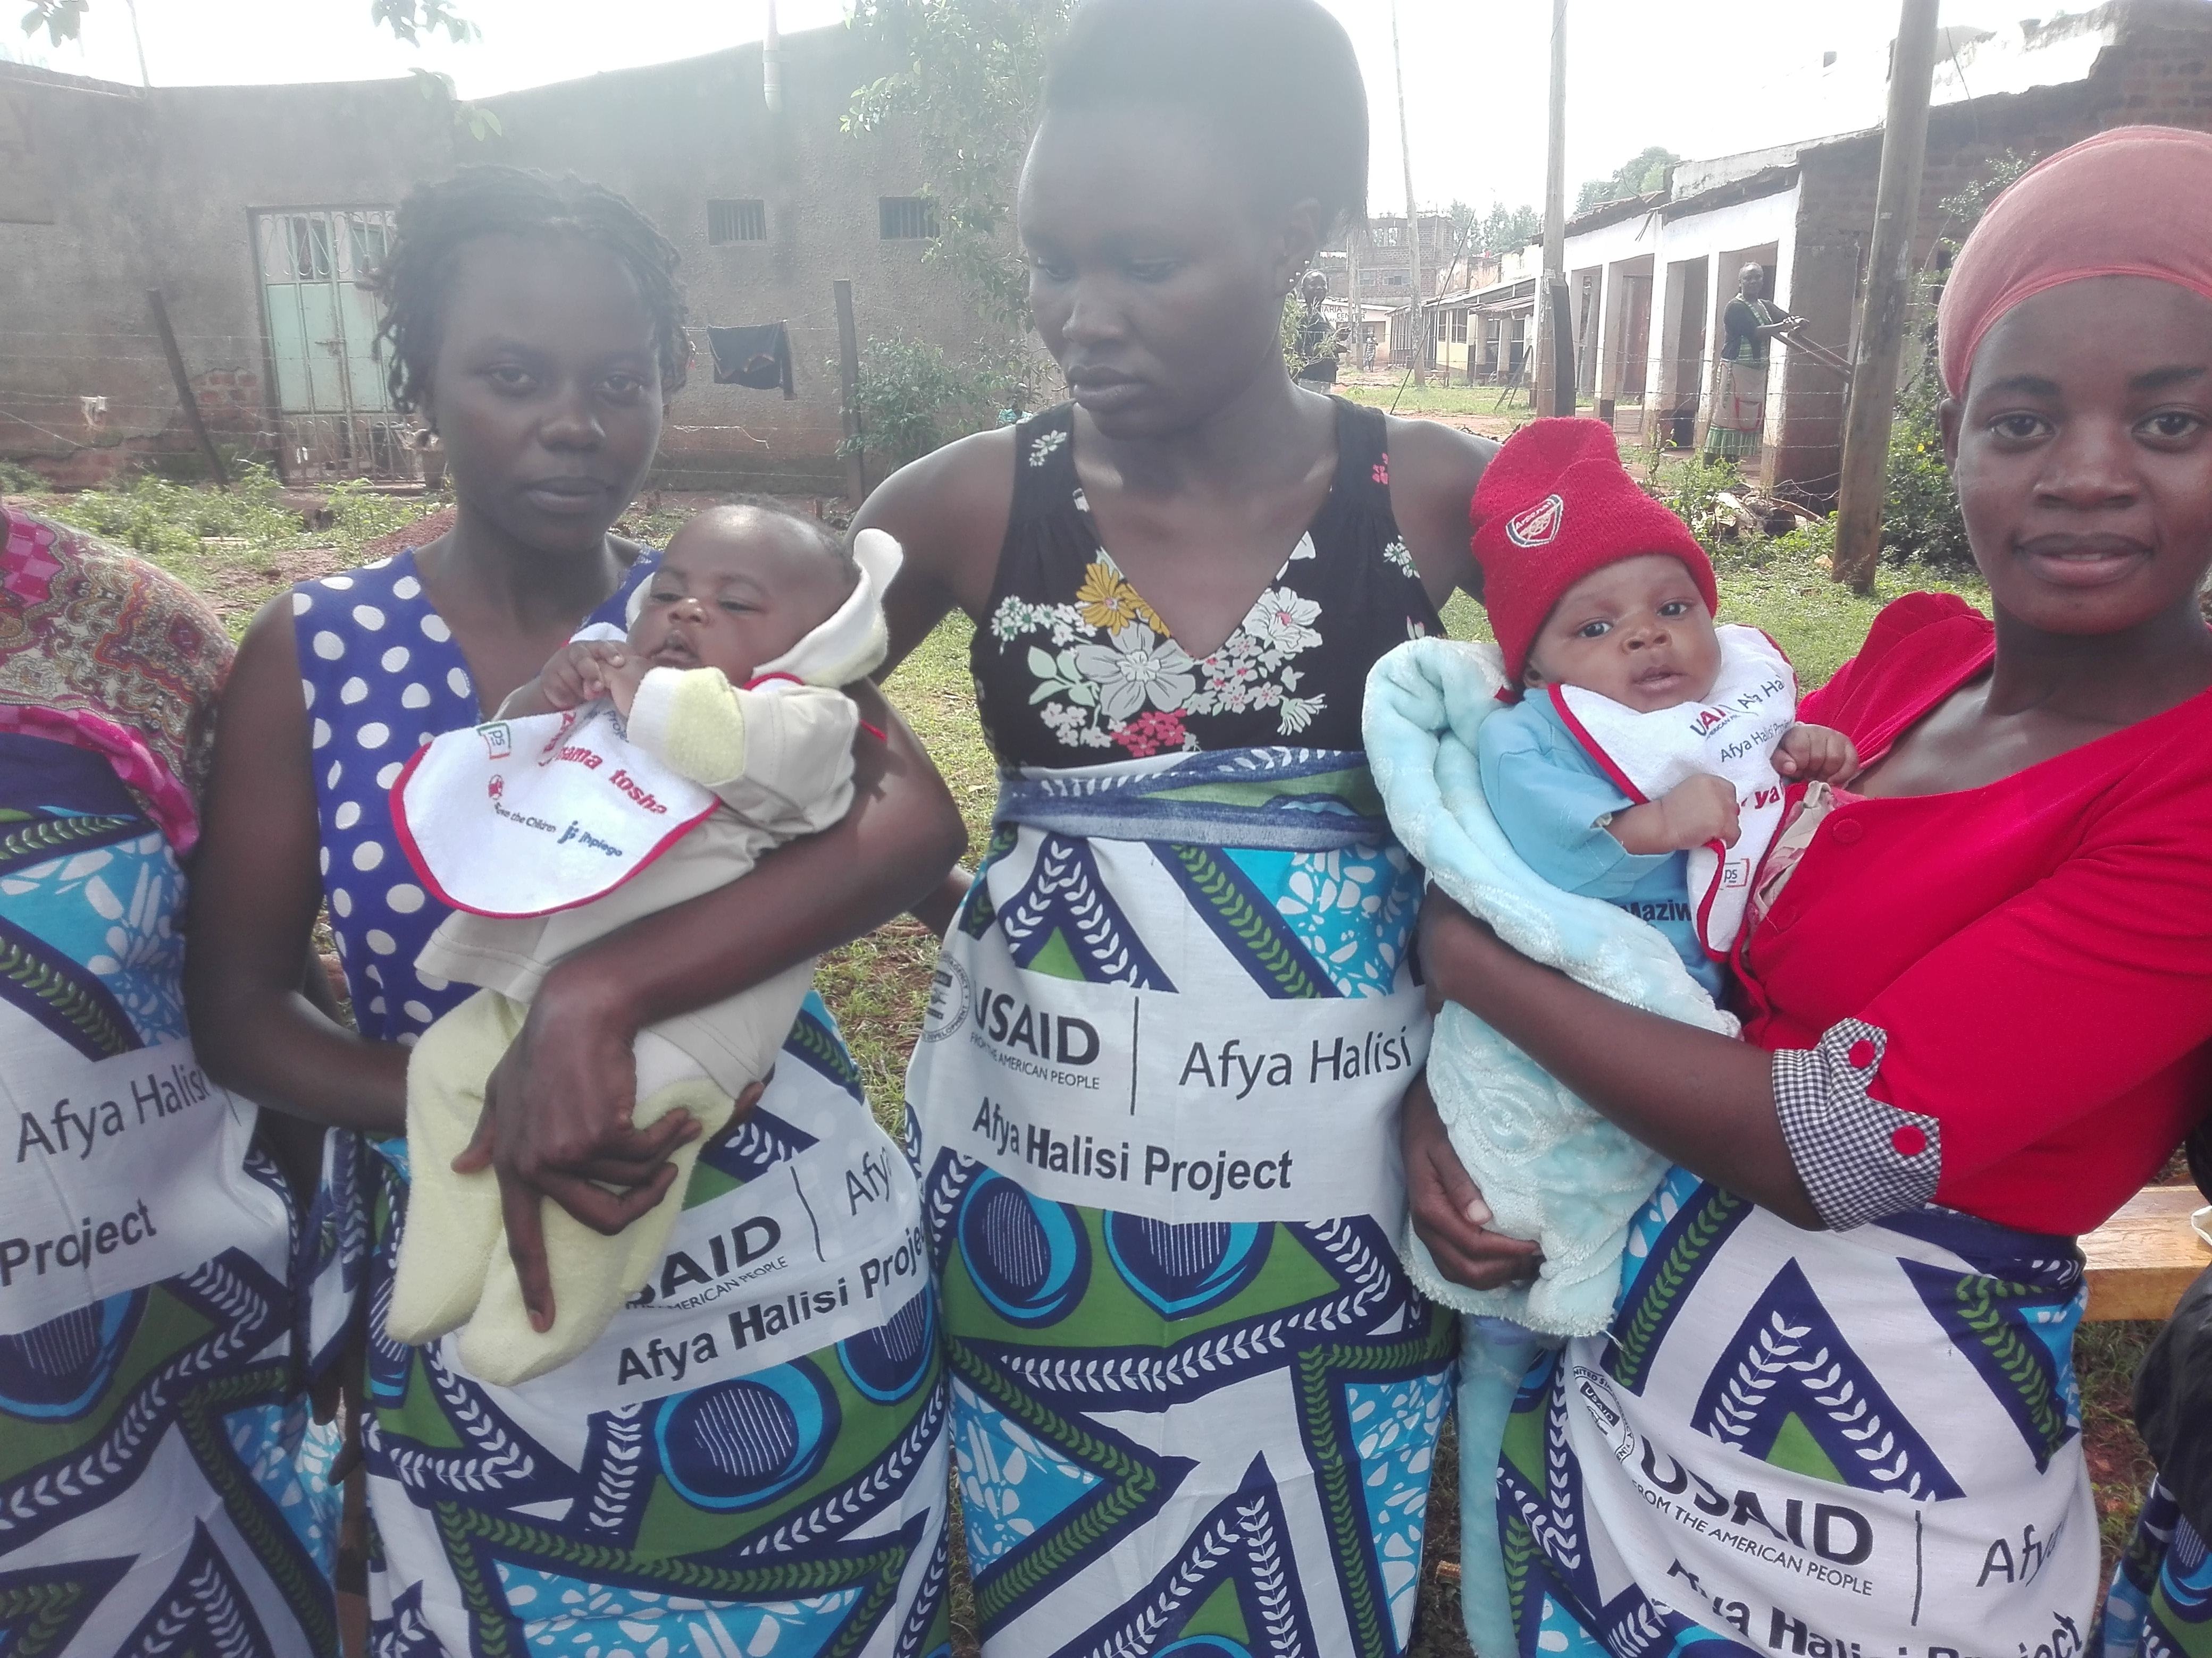
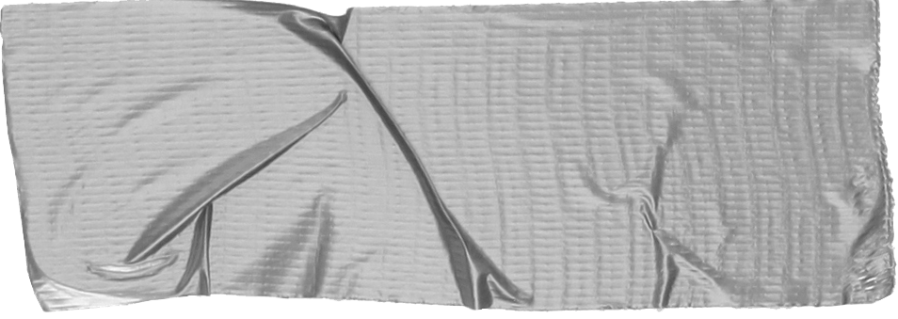
Meet adolescent mothers
No social support
Under care of grandparents
No financial power to facilitate access to services
Stigmatized by community
No One .

Slide 9
Perceived social norms around contraceptive use
Female respondents cited
“My neighbor also told me …… if you use family planning, it reaches a time where you can't give birth, it destroys your eggs and then the eggs die so when you want to have a child, it won't happen. (15-18 female Kisumu )
“I heard it [about FP] from my friends, my sisters. My sisters ask me, to go for planning, I said, I go for family planning and I don't have a family, so what am I planning? they told me. just go for family planning, because if you have a boyfriend you can get pregnant …...so when I {got}pregnant … they chased me away with the child ..” (15-18 female Kakamega)

Slide 10
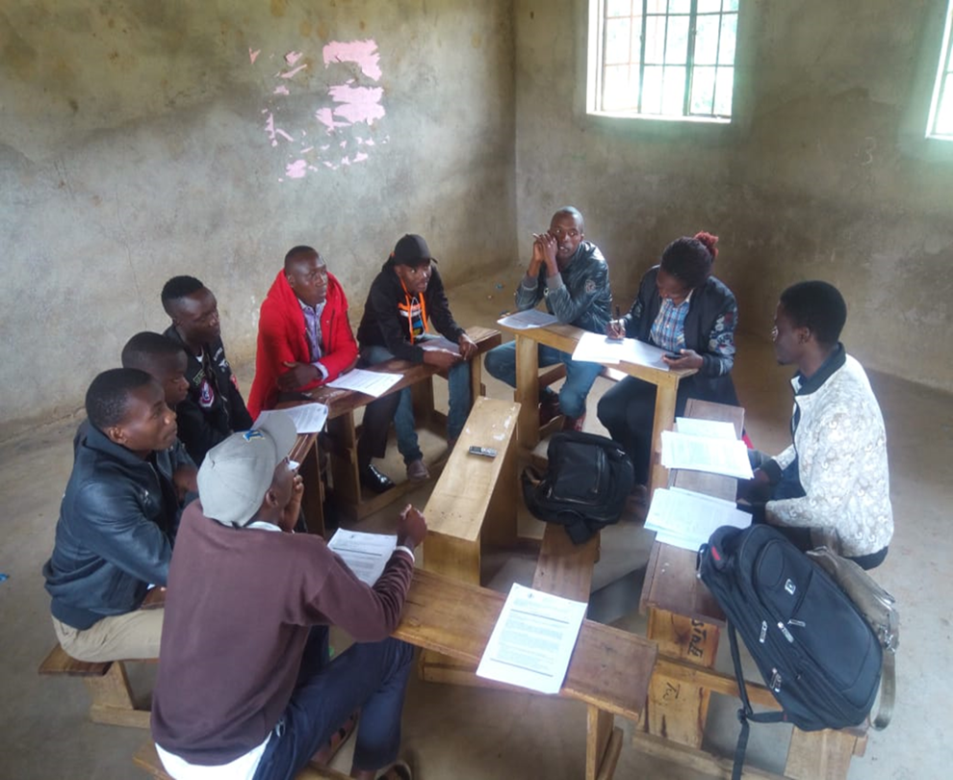
Meet Adolescent Boys
Sexually active
Peer pressure on use of contraceptives
Challenges in where and how to safely get contraceptives
Limited decision making on partner support for services
Story for illustration purposes only

Slide 11
Perception and norms on contraceptives-male adolescents
Norms and perception influenced by
Peers,
Religious beliefs
Fear of side effects
“I think it may be easy or hard for him because it comes about by the advice from his friends who are giving him the bad influence. Sometimes the friends … tell us that you are a man you must do it without protection... you must have unprotected sex....” (15-18 year old male –Kisumu)
“we have seen few churches have been against use, use of condoms …they say that condom is satanic. We are … told that when you use condoms you cannot have enjoyable sex or when you use condoms they can burst and they can cause injuries and then, and the tradition to that they say that the jelly, the jelly which the condoms are manufactured with, can make you become impotent.” (15-18 year old male –Kisumu)

Slide 12
Decision making on utilization of modern family planning methods
Male partners make ultimate decisions & can say no when they:
Want more children
Associate FP with promiscuity
“I can’t use it because my husband does not approve. He says if he finds out I am using them, he will chase me away for good.” (15-18 Female non-user, Kitui)
Adolescent girls at times decide to use FP secretly

Slide 13
Approval of FP use among adolescent girls
Perceived social approval is a key determinant of FP use
Decision on FP use made by their mothers and boyfriends
Some adolescents don’t have social networks to approve of their FP use

Slide 14
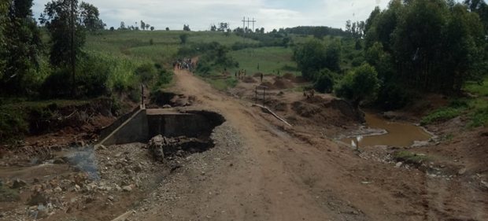
Reasons for NOT attending ANC
Family influences against health facilities
TBAs preferred because of negative provider attitude/being slapped by provider
Long distance to facility
Fear of queueing with older women in health facility
Fear of disclosing pregnancy to harsh relatives
Religious beliefs against hospitals
Long waiting times in health facility

Slide 15
“Some people told me that it [seeking ANC] was hard. They were telling me many things; that I was going to be questioned a lot. They ask a lot of questions and some you cannot even answer. So, it is them that made me more scared and that is why I did not come to the clinic early.”
Utilization of Antenatal Care (ANC)
15-18 female user Kisumu)

Slide 16
Disrespect and abuse during delivery
“She acts very harsh. She will tell you, ‘Can you climb here, you are not the first to give birth. Sit here.’ ... More so, the young girls are mistreated very much… They tell you, ‘Am I the one that advised you to be pregnant?’ She talks very harshly so that you become discouraged in the process of delivery.” (15-18 Female user, Migori)

Slide 17
What are we saying
Need for provider behavior change interventions on how to engage with adolescents
Gender transformative interventions to address harmful gender norms are key
Invest in combined interventions –Community, school and health facility

Slide 18
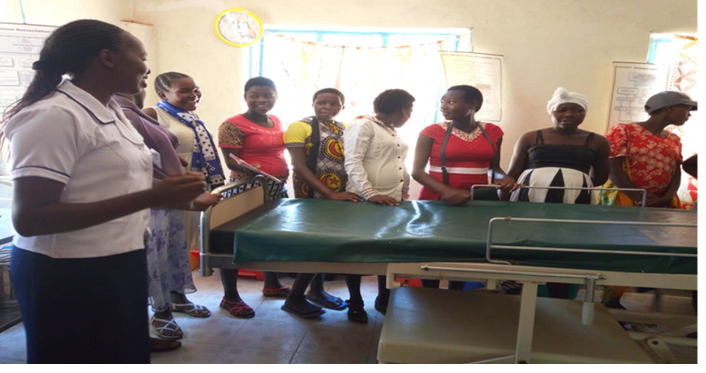
LEARN
Pregnant adolescents touring a delivery room in Kitui

Slide 19
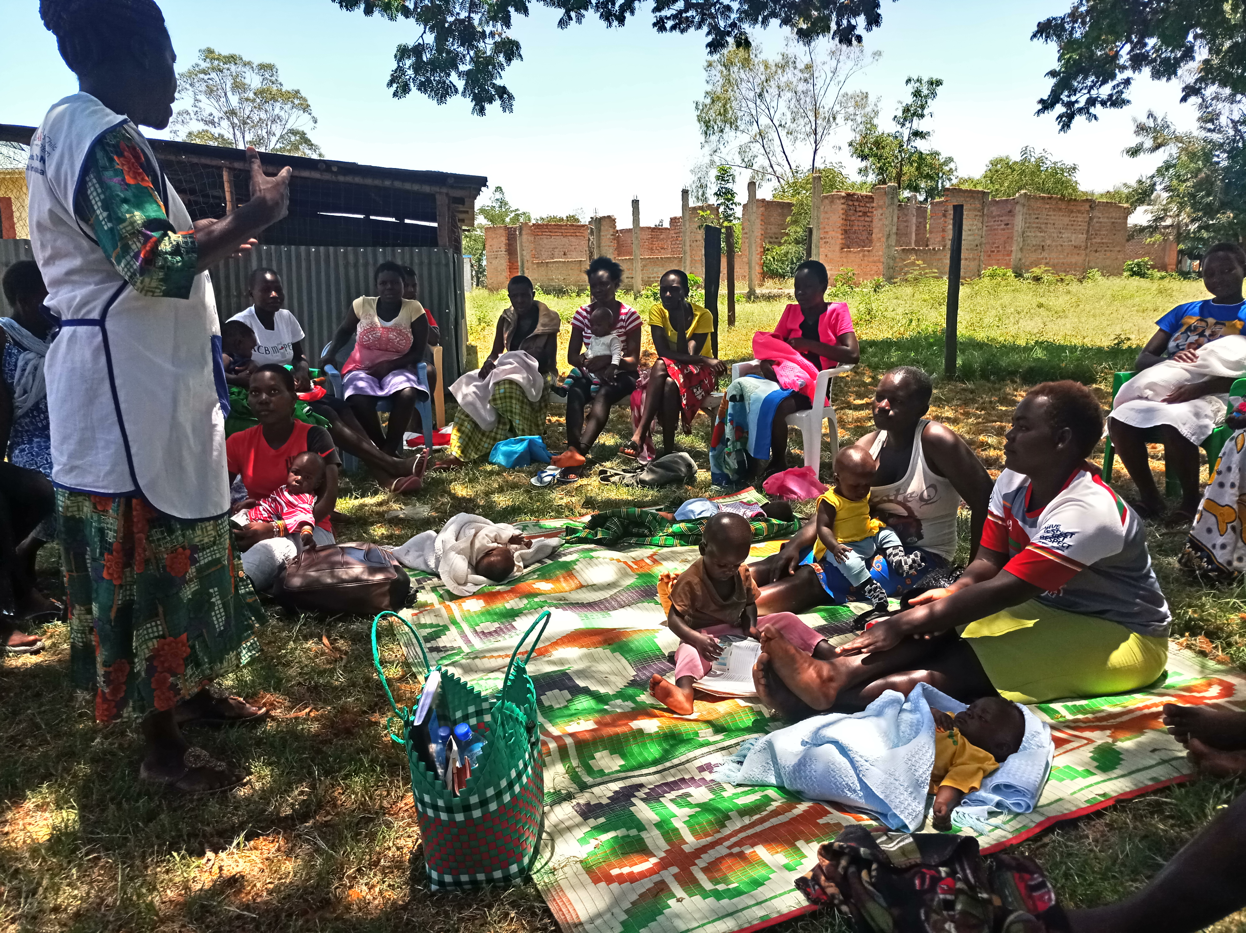
LISTEN
Reaching adolescent mothers at community

Slide 20
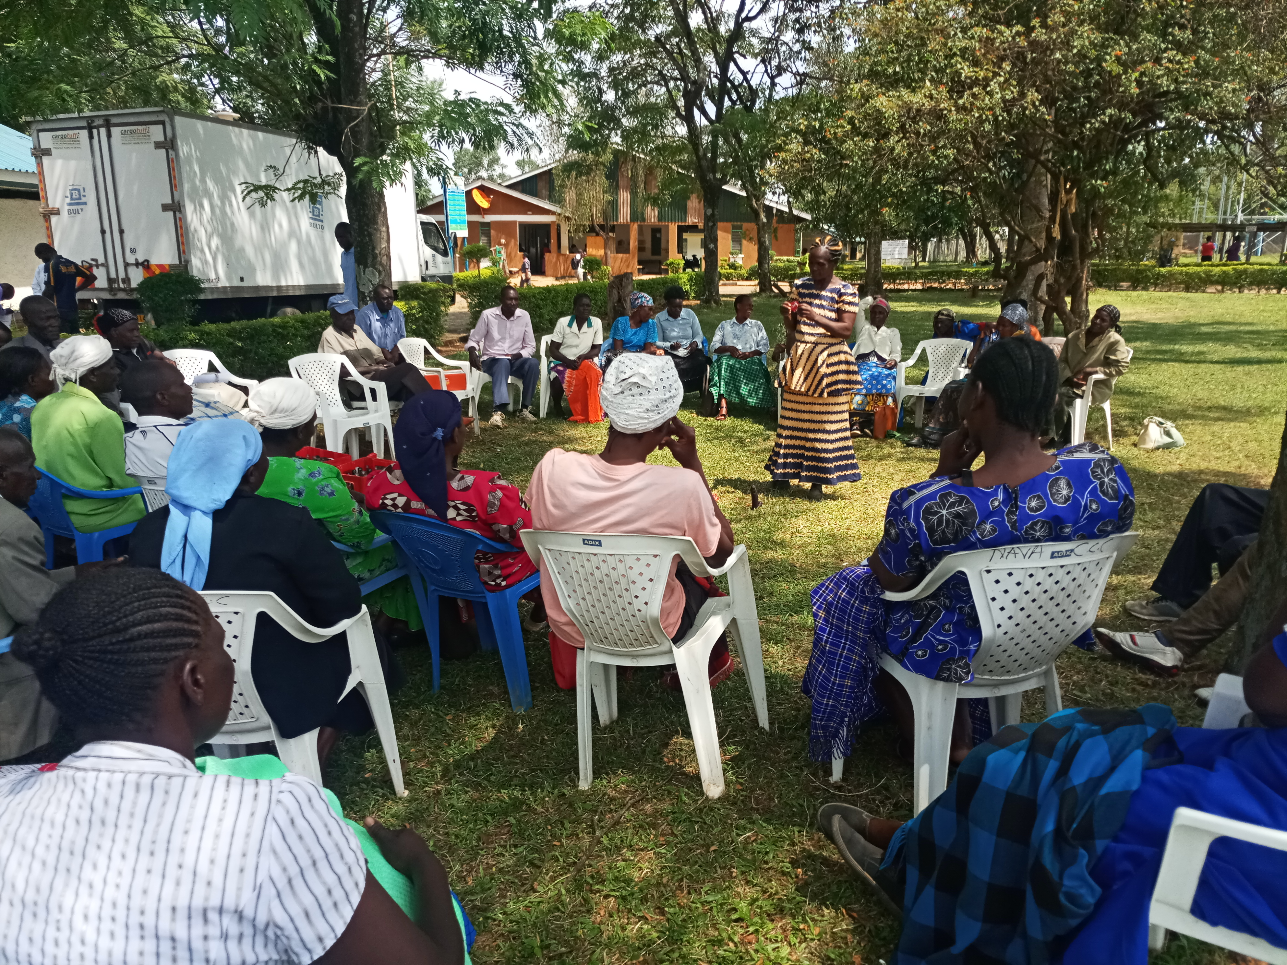
LEVERAGE
Reaching parents of adolescents as a social support mechanism and decision makers

Slide 21
Acknowledgements
Thank you! Carol Ajema
Gender Advisor-Afya Halisi Carol.ajema@afyahalisi.org
Skype: c.ajema

