Slide 1
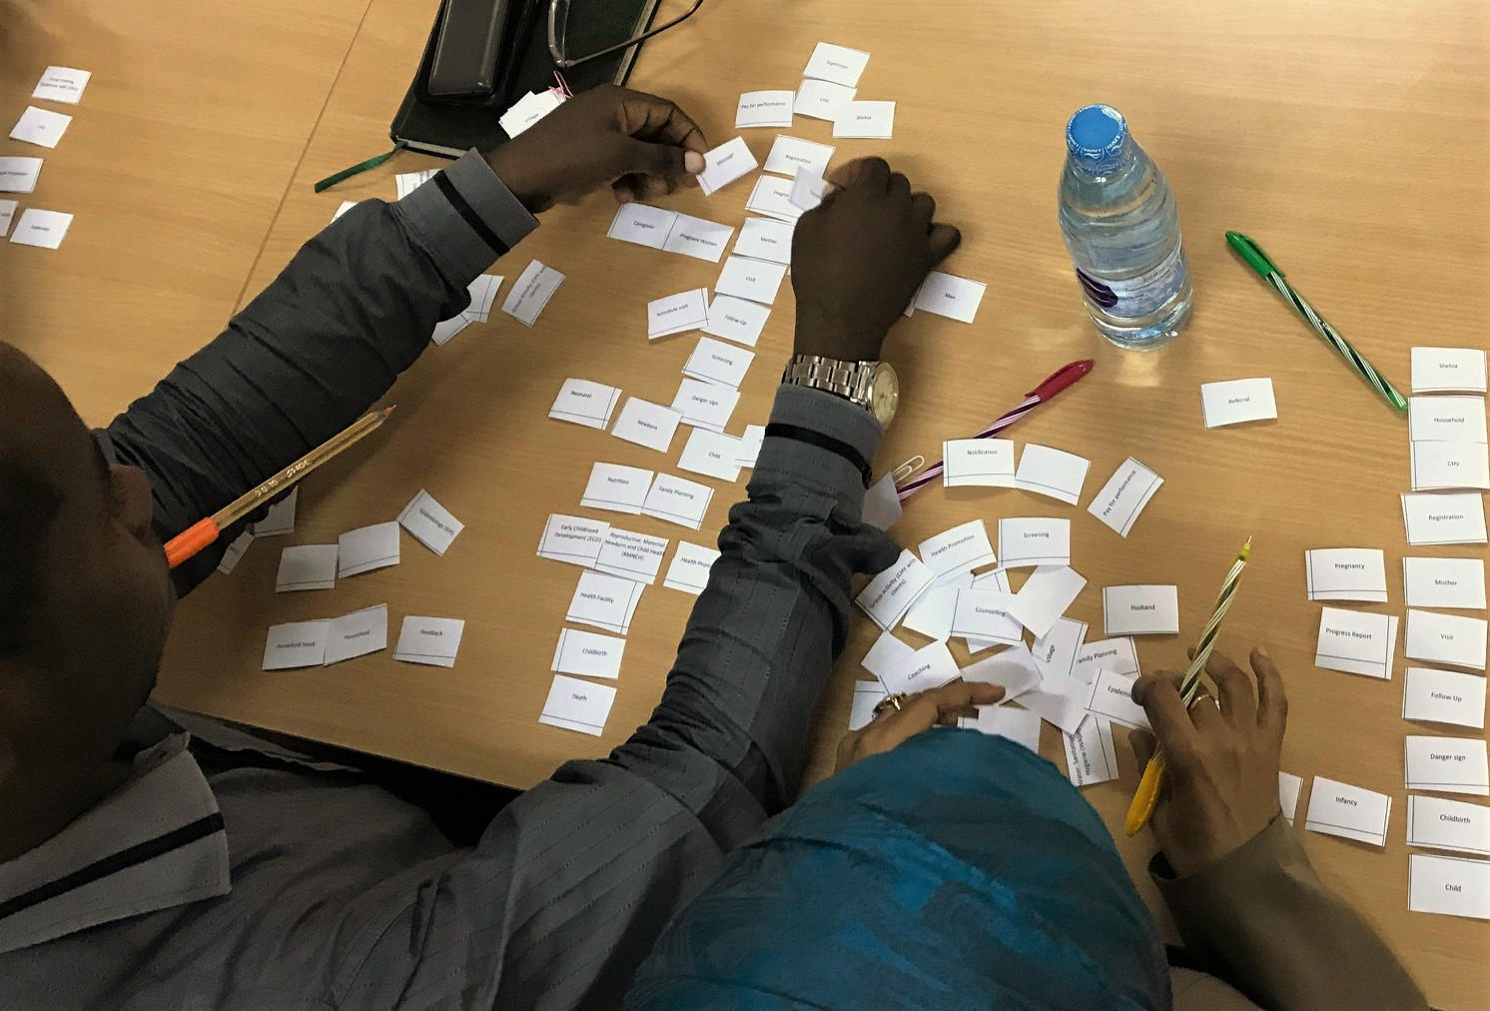
Defining a kaya: Building technology for stronger community health systems
Allyson Nelson
ANelson@d-tree.org

