Slide 1
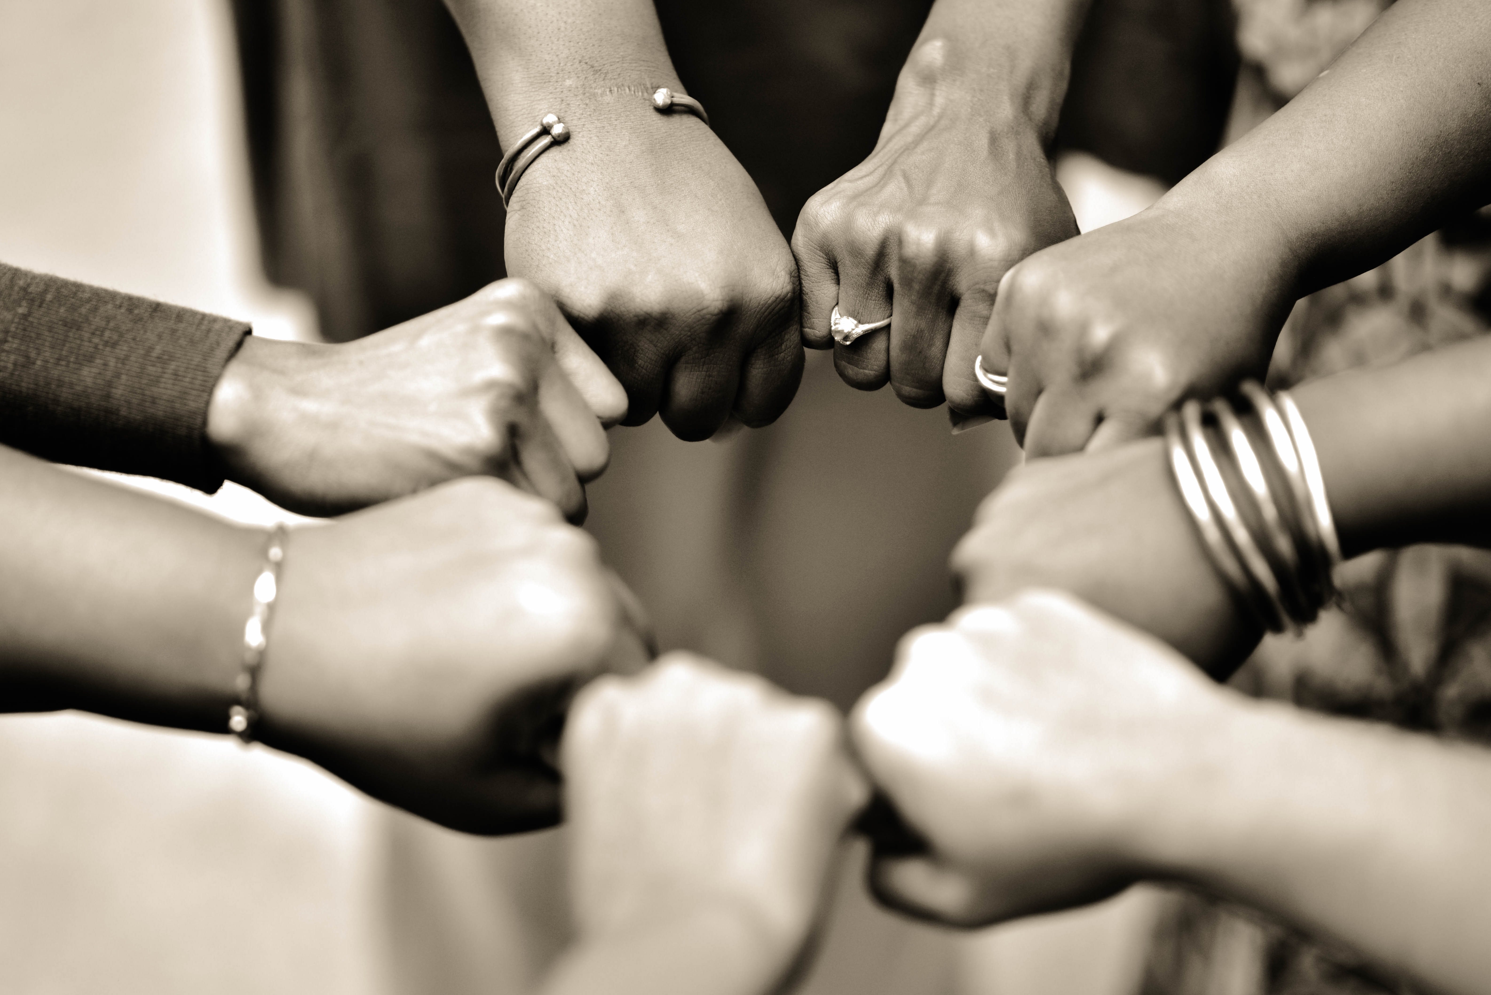

When Women Demand Better: Lessons Learned from Haiti, Lesotho & Kenya
Jenelle Williams, Director of Programs, Global Health Action
Nkatha Njeru, Coordinator, Africa Christian Health Associations Platform
HEALTHY
Healthy People + Healthy Communities + Healthy World

Slide 2
Mission
Our Mission
We engage communities around the world to improve the health and well-being of women, children and adolescents.
We improve and save lives for today and tomorrow. We strengthen and empower communities around the globe with our unique bi-directional, community-centered approach. Through expert training, implementation programs, and meaningful partnerships with the communities we serve, we create sustainable solutions that are designed to address emerging and basic health challenges.
Listen + Connect + Empower

Slide 3


The Numbers
47
97
9,500+
years
active
countries
served
global leaders trained
69 Million +
people with better health and well-being outcomes

Slide 4
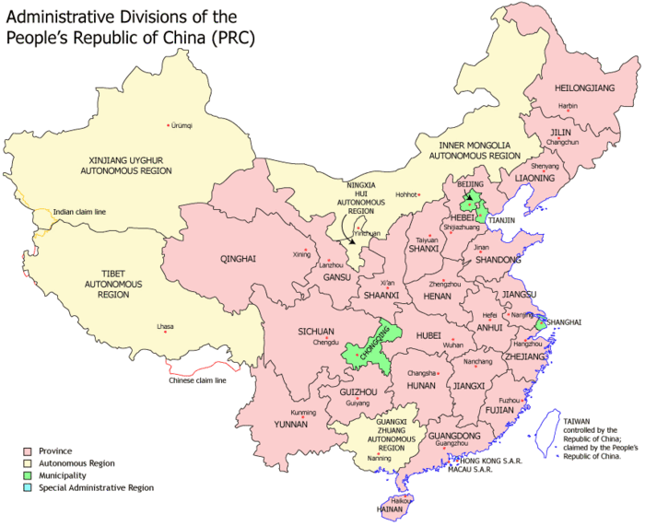
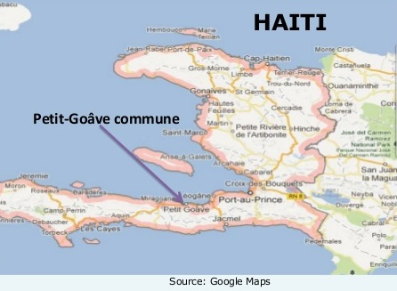
Reach
Our Current Reach
ASIA
SUB SAHARAN AFRICA
CARIBBEAN

Slide 5
Core Values
Power of community
We believe in the power of communities to identify and address their own health needs and improve their quality of life.
Health Equity
Gender Equality
We believe that everyone deserves a fair chance to lead a healthy life. No one should be denied this chance because of who they are or their socio-economic opportunities.
We believe that operating with a gender equity lens is one of the most direct and potent ways to reduce health inequalities and ensure effective use of health resources.
01
Horizontal Strategy
08
02
Empowered People
We believe in a broader, “horizontal” strategy that strengthens overall health systems, rather than a “vertical,” single-disease focus.
07
03
We believe that the key to improving local and global health is to train, educate, and empower individuals, especially the most underserved populations, women, children, youth and older adults.
06
04
05
Catalyst
Partnerships
We see our role as a catalyst to increase the knowledge, skills, and capacity of local leaders and organizations and as a bridge to connect different groups and levels of society.
We believe in partnership and collaboration. Locally and globally, we work with community organizations, national organizations, government agencies, faith-based groups, and NGOs.
Sustainable Solutions
We believe that the ability to have a sustainable impact on people’s health and well-being must come from within the community and be based on a locally appropriate approach and resources.

Slide 6
Partners
Our Partners
Africa Christian Health Associations Platform (ACHAP)
Association Infermiere Sage Femme D’Haiti (AISFH)
Atlanta Public Schools (APS)
Christian Connections for International Health (CCIH)
Christian Health Association of Lesotho (CHALe)
COREGroup
Ecumenical Pharmaceutical Network (EPN)
Eglise Methodiste d'Haiti (EMH)
Foundation for the Advancement of Haitian Midwives (FAHM)
Haitian Pediatric Society
Lesotho Evangelical Church in Southern Africa
Little by Little
National Incarceration Association
Neighborhood Nexus (Atlanta Regional Commission and the Community Foundation for Greater Atlanta)
North Georgia United Methodist Conference
Pan American Health Organization (PAHO)
Societe Haitienne d’Obstetrique et de Gynecologie (SHOG)
UNICEF Technical Working Group on Community Health and Nutrition
United Methodist Women (UMW)
Governments
US Department of Health and Human Services
Nanjing International Training Center
National Health Commission of China
Ministère de la Santé Publique et de la Population (MSPP)
Universities
Georgia State University
Maluti Adventist College
Morehouse School of Medicine
University of Illinois at Chicago (UIC) School of Nursing
Corporations
GlaxoSmith Kline

Slide 7
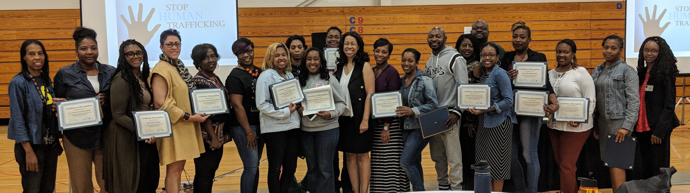
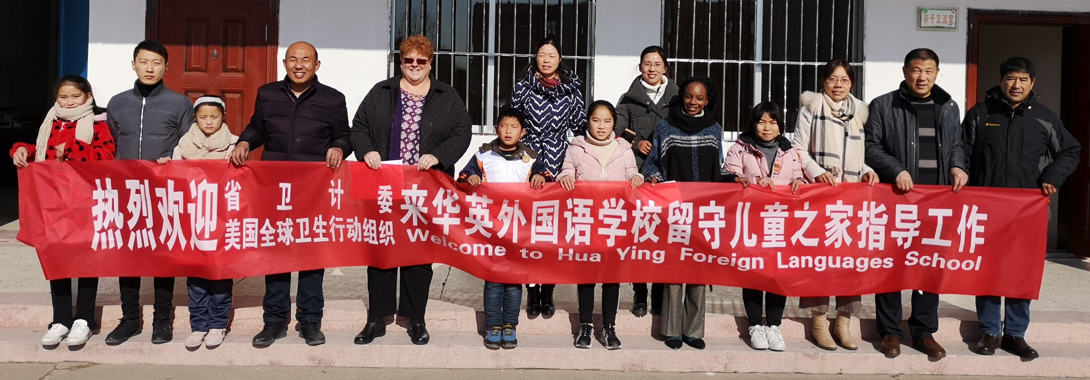
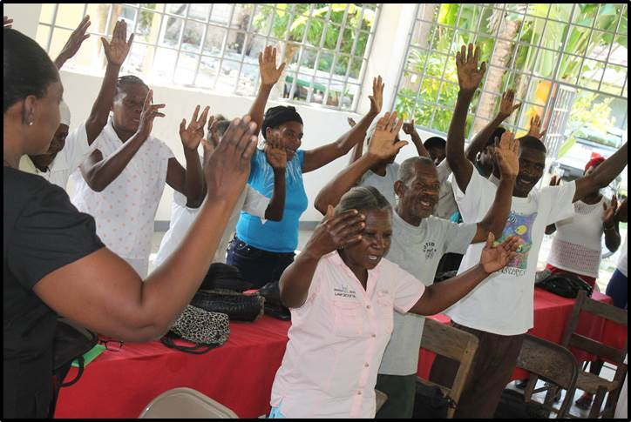
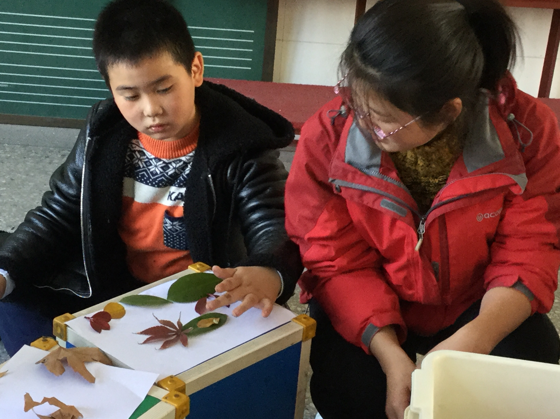
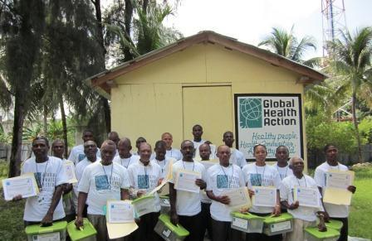
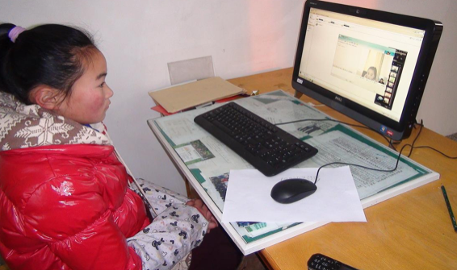
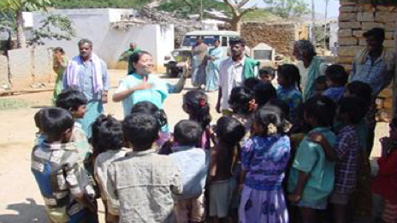
Notes:
Let me ask a question? How many of you know GHA? Please raise your hands if you are in the audience? Fantastic! Ok, thank you! How many of you have never heard of GHA? Well, thank you as well!
I am happy to see old friends and happy to meet new friends today! Thank you!
Now, I would like to take a moment to share a little bit about GHA.
Global Health Action (GHA) engages with communities around the world to improve the health and well-being of women, children, and adolescents. Through
partnerships with government agencies, faith communities, and civil society organizations,
GHA’s programs strengthen community-centered health systems and build community capacity for addressing barriers to health. Since 1972, GHA’s work has impacted people in 97 countries as you can see through the photos on this slide.
Since 2001, we have been working in China and are longtime partners of NITC. Thank you Madame Huang for your invitation for this meeting.

Slide 8
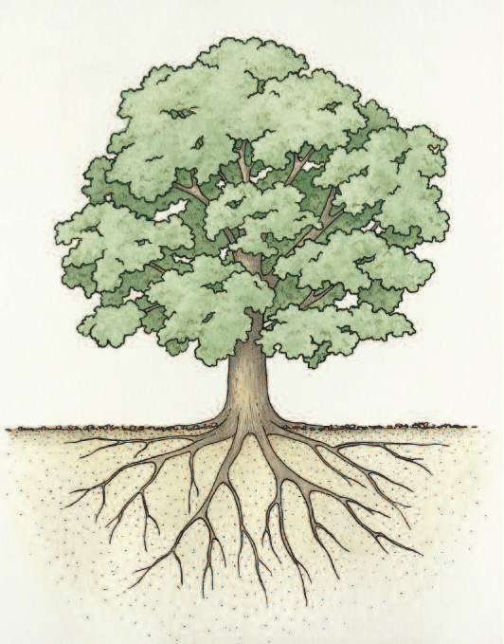
Core Program Areas
Health & Wellbeing
Maternal & Child Health
Youth Health & Wellbeing
Zero to Three
Gender Based Violence
Human Trafficking
Health Systems Strengthening
Human Resources for Health
Leadership & Governance
Essential Medicines
Data
Community Systems Strengthening
Social Capital
Human Capital
Organizational resources

Slide 9
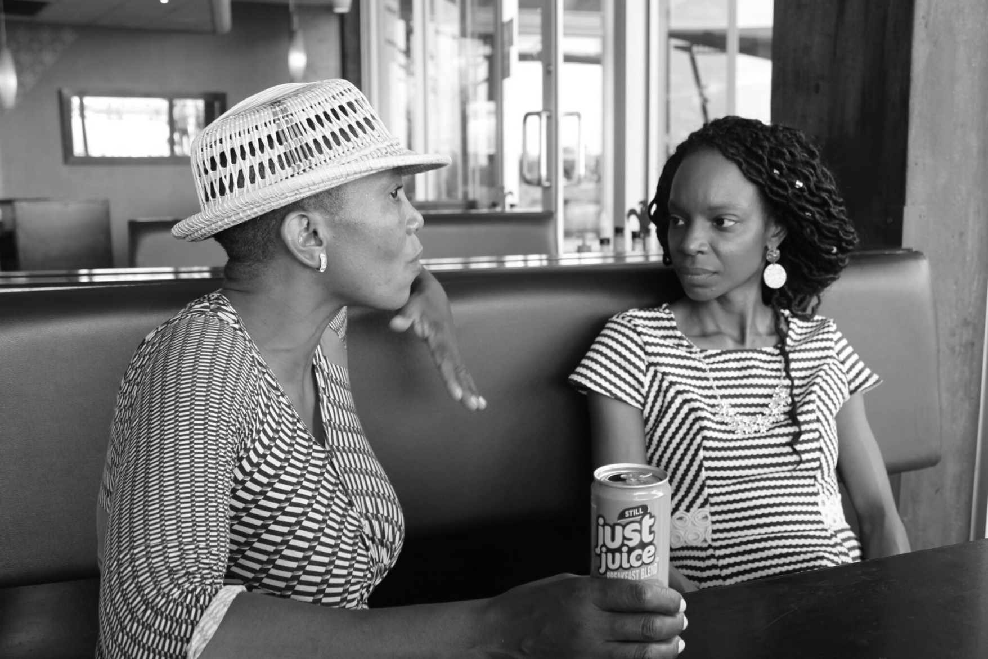

"Women, being a pillar of the community need to be healthy, physically and mentally. This includes them being safe and respected in their relationships. Violence against women weakens the entire community."

Slide 10
Gender Based Violence - psychological, economic, physical and sexual violence – against women and girls has significant impact on their health and wellbeing including - teenage pregnancy, HIV/AIDS, economic struggle, stigma and marginalization according to the Taskforce for V-Day in Haiti.
Notes:
The UNDP has reported that Haiti has one of the highest rates of women affected by violence in the world. Kay Fanm, a Haitian women's rights organization, has estimated that 72 % of Haitian girls have been raped. And, a recent 2009 paper by the Inter-American Commission on Human Rights states that over 90% of Haitian women have experienced some form of violence in their lives.
Human trafficking and Restavek, (the practice of keeping child laborers in the home where they are sometimes sexually and physically abused), are both realities in Haiti.
It was not until 2005 that rape was classified as “a crime against the person,” leading to an increase in the severity of possible punishment.

Slide 11
Gender Based Violence – Haiti Initiative
To improve the lives of women who experience gender-based violence
To decrease injury and mortality due to gender-based violence
To eliminate gender-based violence

Slide 12
The Numbers
28% of women between the ages of 15 and 49 have been physically abused since the age of 15 (MSPP EMMUS V-2012 survey)
13% have been sexually abused at any time in their lives (UNFPA, 2017)
Women who have been sexually and/or physically abused have a 16% greater chance of having a low-birth-weight baby and are two times more likely to abort a pregnancy (UNFPA, 2017)
GBV and child mortality are connected
Gender-based violence undermines the health, dignity, security and autonomy of its victims, yet it remains shrouded in a culture of silence.

Slide 13
Forms of Gender Based Violence
Physical Violence
Sexual Violence
Psychological Violence
Economic Violence
Notes:
Physical violence
Any act which causes physical harm as a result of unlawful physical force. Physical violence can take the form of, among others, serious and minor assault, deprivation of liberty and manslaughter.
Sexual violence
Any sexual act perfomed on an individual without their consent. Sexual violence can take the form of rape or sexual assault.
Psychological violence
Any act which causes psychological harm to an individual. Pyschological violence can take the form of, for example, coercion, defamation, verbal insult or harassment.
Economic violence
Any act or behaviour which causes economic harm to an individual. Economic violence can take the form of, for example, property damage, restricting access to financial resources, education or the labour market, or not complying with economic responsibilities, such as alimony.
It is also important to recognise that gender-based violence may be normalised and reproduced due to structural inequalities, such as societal norms, attitudes and stereotypes around gender generally and violence against women specifically. Therefore it is important to acknowledge structural or institutional violence, which can be defined as the subordination of women in economic, social and political life, when attempting to explain the prevalence of violence against women within our societies.

Slide 15
At Least 4 categories of Gender Based Violence
Community mobilization
Behavior change
Service delivery
Laws and public policy
Notes:
GBV programs generally fall into four categories: community mobilization; behavior change communication; service delivery; and law and public policy. Community mobilization programs tend to mobilize multiple community groups including religious organizations, traditional leaders, schools, sports groups, police stations, and NGOs to establish priorities for addressing GBV and to identify local resources to fight GBV. Community mobilization programs engage, support and empower communities to challenge cultural norms that contribute to overall levels of violence by using participatory approaches. Behavior change communication programs tend to challenge prevailing beliefs and norms that contribute to the acceptability and perpetuation of violence. They also influence individuals’ awareness, attitudes, behavior, and external environment. In addition, BCC program try to reduce survivors’ isolation and create an environment conducive to change by acknowledging the widespread nature of GBV. Service delivery programs generally help to detect cases of violence and provide victims with the care that they need; document information in ways that can be used as evidence in court; and address consequences of GBV for women’s health. Service delivery programs can also provide emergency contraception to women in advance of need, assist women with safety planning, and facilitate women’s access to additional services including legal and social help. Legal and policy programs generally serve to make GBV a legitimate human rights issue. If well implemented and enforced, they can protect women from GBV and hold abusers accountable for their behaviors. Institutional policies provide guidance to staff members and send a message that violence will not be tolerated. Policy efforts also influence the allocation of appropriate resources to GBV prevention/mitigation

Slide 16
LISTEN | CONNECT | EMPOWER
Notes:
Women leaders within the national structure of the Methodist Church of Haiti (EMH) identified women’s leadership and empowerment as a priority and developed a project to address that concept. GHA provided some technical assistance in program design and evaluation of the series of leadership development seminars developed and led by the team of EMH women leaders. The seminars included training about the role of women as change agents within church history and dialogues where women across Haiti had a chance to share what they saw as their priorities and challenges in their communities. Gender based violence became a consistent theme and priority for women across communities. Women began to strategize around action plans to address this in their communities.
Foundation for the Advancement of Haitian Midwives and locally Haitian led organizations including One Billion Rise, the Haiti Society of OB/GYN, and the Haiti Midwifery Association to co-host a GBV prevention and intervention conference for midwives in Nov 2018. The conference required self-reflection and examination of personal ideas and biases related to violence, sex, and barriers to seeking care. These included cultural and societal norms affecting health, sexual and reproductive health, respectful and privacy-protected care, principles of trauma-informed care, types of gender-based violence, human and women’s rights according to Haitian law, medical exam of victims, the medical-legal aspects of reporting and ethics, and professional development.
Outcome: 22 midwives from across Haiti’s districts attended the training. Empowering Haitian midwives with the knowledge, skills and sensitivity required to work with GBV victims lays the foundation for a sustainable model of care. Haitian Midwives are part of the community in which they live and work. They are in the optimal position to provide culturally sensitive evidence-based care to Haitian victims and survivors. Not only did healthcare workers have paradigm shifts in their understanding and care of women traumatized by GBV but GHA connected the midwives and trainers to the EMH health leadership with the intention to develop further programming through connections as resources for communities.

Slide 17
I feel better prepared to counsel survivors and families in addressing psychological and emotional trauma…
because thanks to this training, I finally understand that sexual assault victims are not responsible for their rape and we should not judge them.
I feel better prepared to perform respectful trauma informed care for survivors of sexual violence…
I realize that the way we greet patients is not Ok and that confidentiality is not respected by the medical and paramedical staff.
I would like to improve how we greet patients; take a look at the available protocols and check if they are up to date; make a proposal to my superiors.
I plan to make changes at my work by personally changing my behavior and educating my colleagues.
SERVICE DELIVERY

Slide 19
AFRICA CHRISTIAN HEALTH ASSOCIATION PLATFORM
Gender Based Violence Lessons Learned & Opportunities Moving Forward

Slide 20
M&E Challenges for GBV
Hard to separate contribution of multiple strategies
Lack of investment in rigorous evaluation
  limited evidence of effectiveness
Non-standardized GBV definitions and indicators
Enhancing comparability of data
Climate of urgency around results but behavior change is long-term
Notes:
One of the major challenges of evaluating GBV programs is how to attribute change. Many activities are ongoing so it is difficult to say how much of an observed change is due to a particular activity. GBV programs also tend to be multifaceted, making it necessary to have multiple measures across disciplines and sectors. In general, programs have not invested in rigorous evaluations. Sometimes, this is due to the program design. For example, if a program provides complete coverage, it is impossible to have a control or comparison group. But even in situations where programs are not full coverage, use of strong quantitative evaluation designs is rare. So many programs have limited evidence of their effectiveness. Although many people agree that it is important to prevent and mitigate gender-based violence, there is no consensus on how to define indicators and make them operational. Few programs collect data or measure indicators in a systematic way, making it difficult to compare programs across space and time. An additional challenge is that there is often a climate of urgency around results, whereas gender norms and GBV trends take a relatively long time to change.

Slide 21
M&E Challenges for GBV
Sensitive nature of the information and hidden forms of violence (homicide, trafficking, female genital mutilation)
Changing violence levels hard to measure and interpret
Ethical and methodological issues
Notes:
Monitoring and evaluating GBV programs bring additional challenges. Many indicators for behavior change rely on household surveys to track knowledge, attitudes, and practices related to GBV. The quality of self-reports on GBV victimization or perpetration is suspect, given the sensitive nature of the relevant behaviors. Moreover, there is a culture of silence around GBV and normalization of related behaviors in some settings. Thus, there is considerable potential for under-reporting, especially in cases where violence is hidden, as with female homicide and sex trafficking. If the quality of data is constant over time, under-reporting of GBV will not affect conclusions on the direction of trends, although the absolute levels of GBV will be incorrect. However, if the quality of data varies over time, trends can be distorted. It is common for reporting of GBV to improve over time as programs acknowledge the widespread nature of GBV and send a message that it will not be tolerated. Finally, M&E of GBV programs raises a number of ethical and methodological challenges. For example, care has to be taken to ensure that the victim is not put in any danger by data collection, especially as some of the women and children may be in vulnerable or abusive situations that might be uncovered by data collection. Protocols that handle these situations while also maintaining confidentiality need to be developed ahead of time. Data collection and research teams also have to be carefully selected and need to receive specialized training and on-going support. Active efforts must be made to minimize any possible distress caused by the research.

Slide 22
Roundtables:
Questions for your tables:
  What does Gender-Based Violence look like in your community or country? How is data collected?
  What successful strategies and programs are in place? What makes them successful?
  What roadblocks exist in your community? What are some strategies to address them?
  What types of monitoring and evaluation systems can be developed to track gender-based violence?
  This is a long term issue but funding is usually short term…what is the solution?
Notes:
Uganda M&E work: created a pilot to create indicators to be adapted
taskforce created with 4 areas:
how many clients had 2 services
minimum package for gender integration (is it there)
DHIS
gender in the
supervision
quality improvement
integrating gender at health facilities
what is the strategy for strengthening gender
--experience with the police
men involvement strategy -- male masculinities at the community level
gender monitoring
men groups**
Humanitarian example - darfur m&e

Slide 23
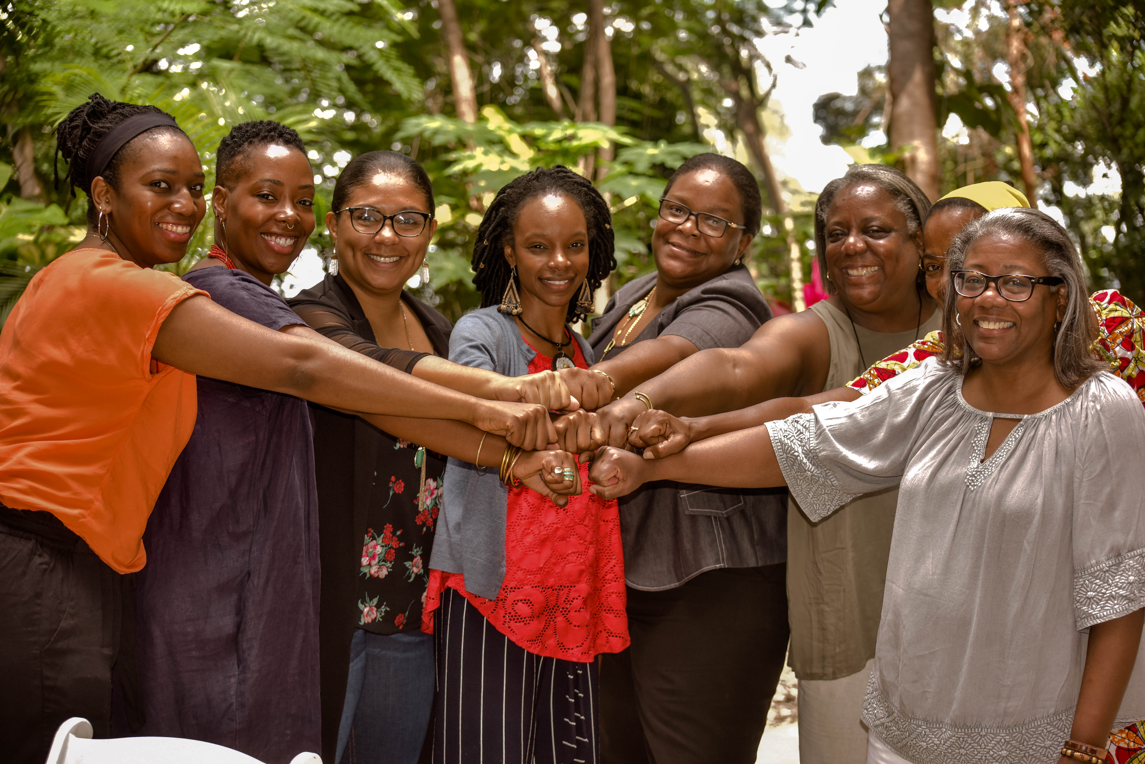
Thank you!

