Slide 1
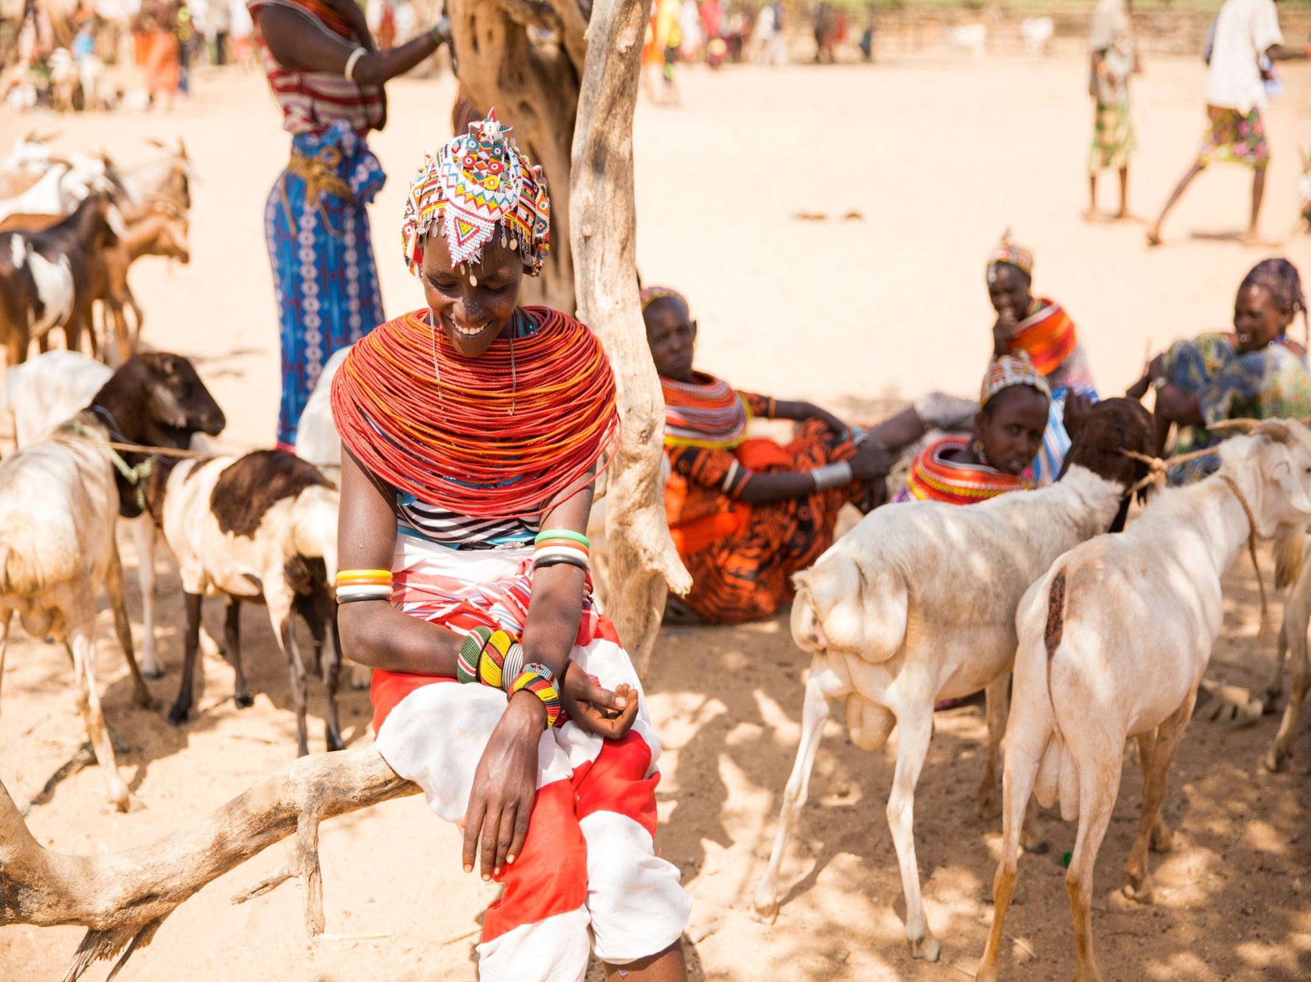
Using community strategies to improve health outcomes; A case of integrated health and nutrition outreaches and participatory learning and action cycle

Slide 2
Session Brief
Background of Marsabit County
Brief of Integrated health and nutrition outreaches
Outreach sites prioritization
Roles of stakeholders
The How?
Factors contributing to success, Challenges & Recommendations
Services offered in an outreach site

Slide 3
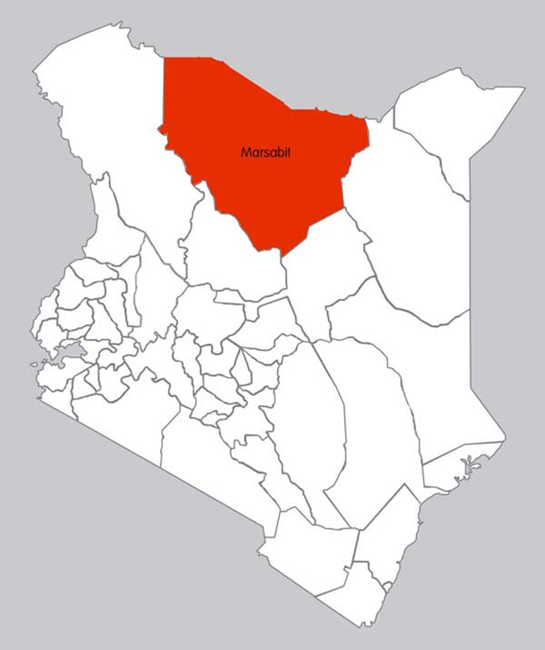
Marsabit County
Marsabit is an ASAL
It’s vast and sparsely populated covering 75,750 SqKM
Has 88 government and faith based health facilities
Has approximately 325,960 people
GAM =18%
Drought is recurrent

Slide 4
Integrated health and Nutrition Outreaches: Brief
Outreach work entails delivering integrated health and nutrition services to the community members located in remote places, far from health facilities

Slide 5
Outreaches fit in UNICEF Conceptual Framework

Slide 6
Outreaches contribute to HSS

Slide 7
Outreach sites prioritization
Priority 1
Priority 2
Priority 3

Slide 8
Role of stakeholders
GOK
FH Kenya
FH Kenya partners with the local government by providing logistical and technical support needed to reach the remote places
The government of Kenya (GOK) through the department of health provides technical personnel, anthropometric equipment, therapeutic and supplementary foods, supplements, dewormers, vaccines and essential medicines for treatment of minor ailments

Slide 9
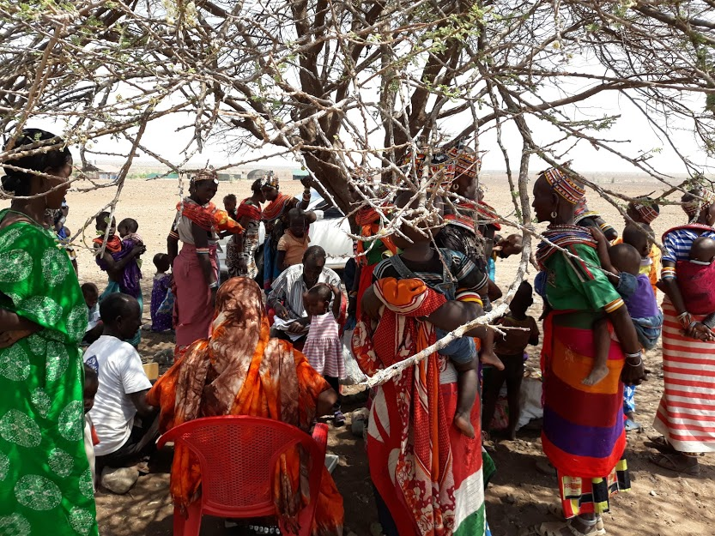
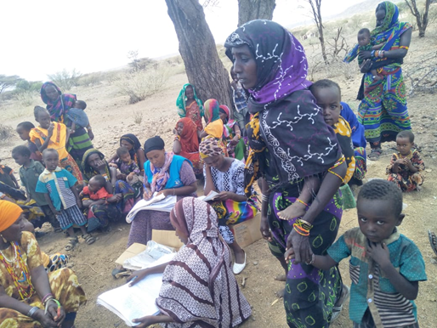
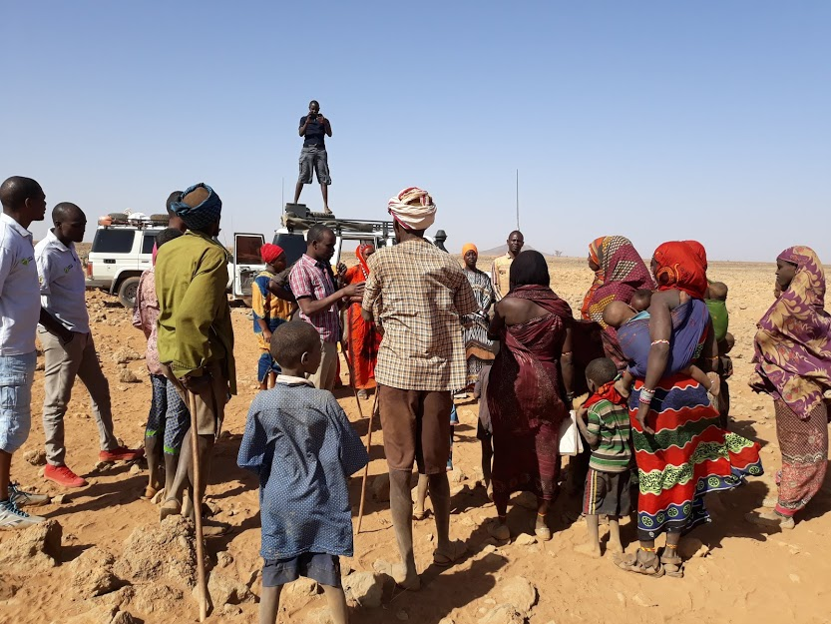

Slide 10
Services offered at the outreach visit
Screening and management of malnutrition
Diagnosis and treatment of common and minor ailments
Vitamin A supplementation for children 6-59 months
IFAS supplementation for ANC women Routine Vaccination
Deworming for children 12-59 months
Provider initiated testing and counselling
RH services including FP, ANC

Slide 11
Contributing factors for success of outreach work
Ownership, Commitment and leadership by the MOH-GOK in planning and execution of activities
Budget allocation and prioritization of outreaches in the County budgets
Availability and active participation of sub county health management committee (SCHMT) in supervision
Availability of adequate health workers and CHVs
Availability of adequate nutrition commodities, anthropometric equipment, drugs and treatment equipment’s and reporting tools
Excellent community mobilization
Improved health seeking behavior
Male and elderly involvement

Slide 12
Challenges
Outreach work is resource intense
Inadequate County budget allocation for health
Inadequate staffing
Cultural beliefs that are a barrier to health seeking behavior
Heavy rainfall makes some roads impassable

Slide 13
Recommendations
Working in liaison with the National, County government and community
Adequate budget allocation for health and nutrition
Complementary SBCC interventions are essential
Increased GOK staffing & CD
Operationalization of static H/F

Slide 14
Video

Slide 15
Resource documents
National Guideline for Integrated Management of Acute Malnutrition; Version 1: January 2019
Standard operating procedures (SOPs) for expanded community outreach during nutrition emergencies- May 2017

