Slide 1
Quality and respectful care for mothers and newborns in childbirth and the postpartum period: Kenya leading the way
Dr. Wangui Muthigani
Ministry of Health

Slide 2
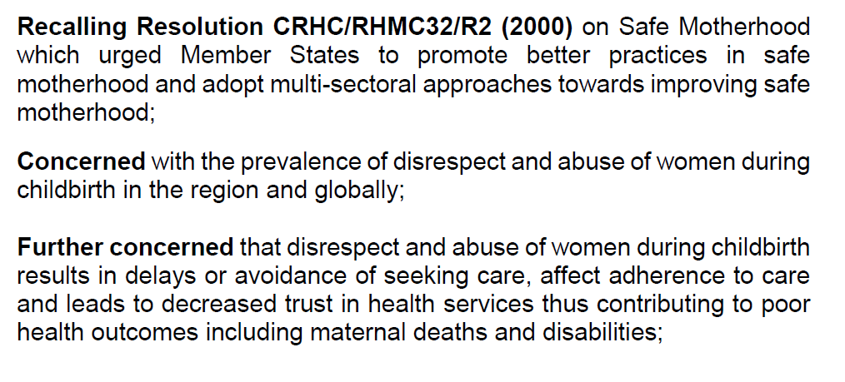
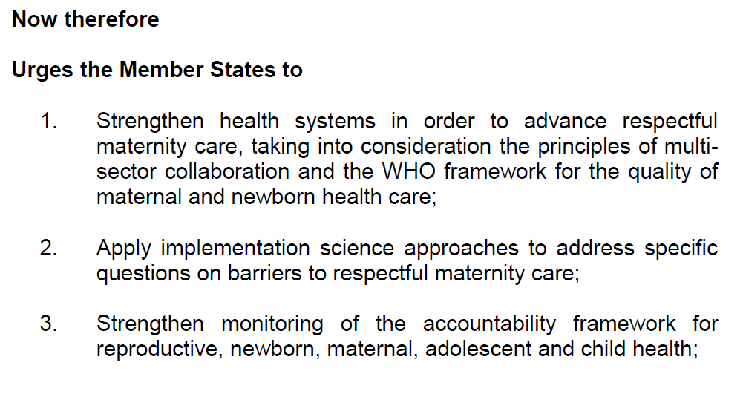
Regional Committements
Resolution from 65th ECSA HMC (2018)

Slide 3
Kenya - Quality Guiding Documents
The Kenya Constitution 2010
Health Act 2017
Kenya Health Policy (2014-2030)
Norms and standards (e.g. HRH, and infrastructure)
Kenya Quality Model for Health Standards and Checklists
Joint Health Inspection Checklist

Slide 4
Quality Service, A right
Kenya Constitution, chapter 4 Article 43 on Bill of rights
Right to the highest attainable standards of health, including reproductive health and emergency treatment
Vision 2030 ……
Calls for provision of efficient and high quality healthcare systems with the best standards

Slide 5
Dimensions of Quality
Accessibility
Safety
Timeliness
Effectiveness
Efficiency
Acceptable
Client Centered
Equitable
Respectful care

Slide 6
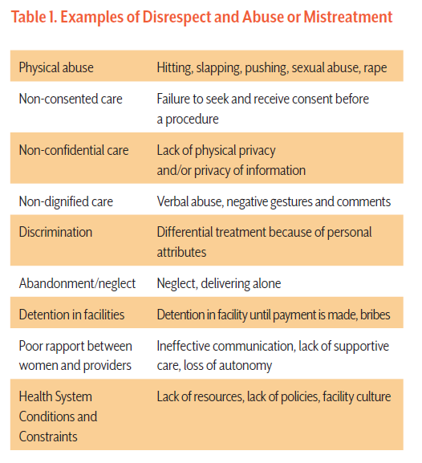
Quality of Care- Experiences of Maternity Care

Slide 7
Mistreatment in East Africa: Implementation research evidence
Regional Commitment
Regional Commitment
Regional Commitment
Tanzania: Tanga: 19% reported at least 1 of 14 instances of disrespect and abuse (at exit), 28% (home follow-up)
Tanzania: Dar: 15% (at exit) reported 1 of 18 instances of disrespect and abuse, 70% (home follow-up)
Kenya: 20% reported being humiliated (at exit)
Care-seeking implications: Disrespect and abuse is associated with lower intention to deliver in a health facility in the future
Notes:
Emily

Slide 8
Confidential Enquiry into Maternal Deaths
Assessment of Quality of Care

Slide 9
Why do poor experiences matter?
Poor Quality of Care has safety, human rights, and ethical implications that can lead to:
Poor health outcomes,
Reinforce mistrust of health services,
Lead to delays/avoidance of institutional care-seeking in the future.

Slide 10
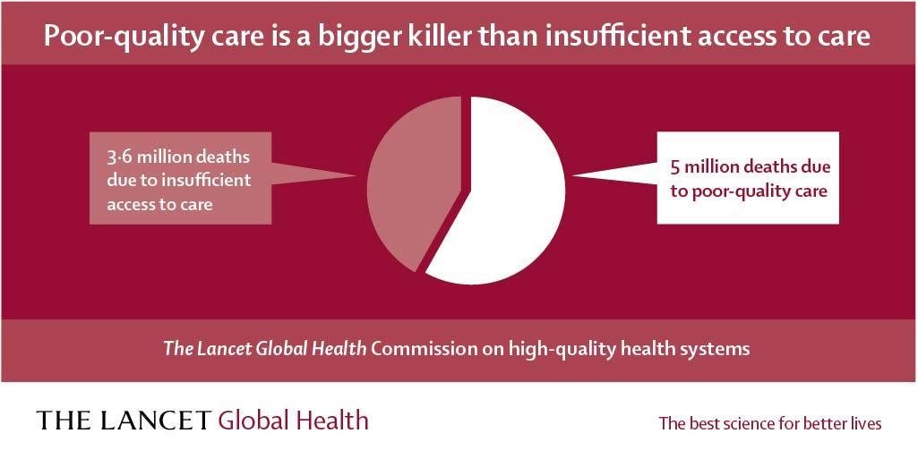
Quality of Care for RMNCAH & UHC
Poor quality of care is responsible for 1 million newborn deaths and over half of maternal deaths!

Slide 11
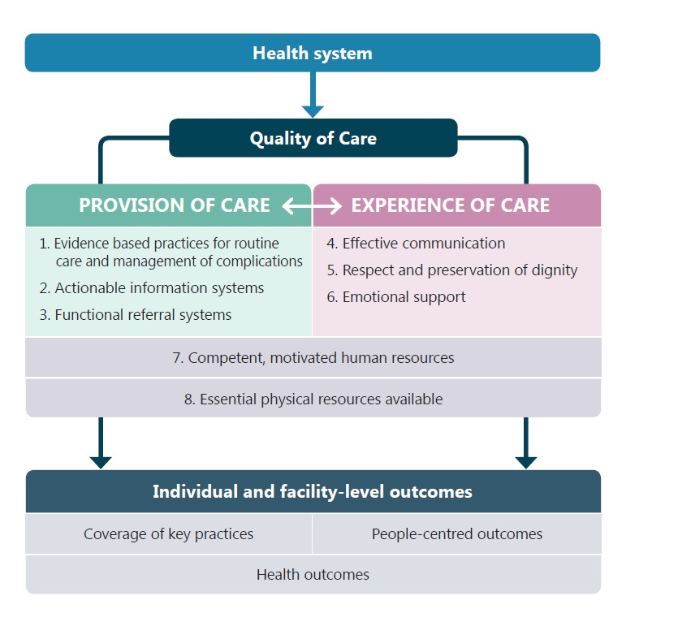
Quality of Care
Notes:
Global guidelines

Slide 12
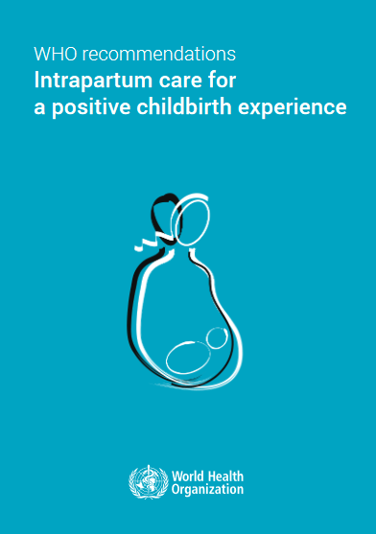
Global Action to Advance Respectful High Quality Care
WHO statement on Disrespect and Abuse, RMC Charter
Global Guidelines and Norms by WHO (MNH, intrapartum, child)
Proliferation of research Studies
Communities of Practice/Learning
Quality, equity and dignity network
RMC Global Council

Slide 13
Evidence into Action for Respectful Care: Kenya
Policies and Strategies
National MNH Health Implementation Strategy
Health act 2017
Revised Policies, standards and guidelines (MPDSR, MNH etc)
RMC training package
Quality of care for MNH (draft)
Routine Monitoring
Supervision checklist
MPDSR and verbal autopsy
Promising approaches/practices (scaled-up)
Maternity Open Days (continued)
Training on RMC components
Evidence availability and sharing
Enhance advocacy efforts continue- through media and CSOs
Continue to share best practices

Slide 14
Discussion on Progress & Lessons Learned:
Advancing High Quality Respectful Care
Policies and strategies
Routine Monitoring- how do we track progress
Promising Approaches/ Practices
Evidence Availability and Sharing

Slide 15
Conclusion
RMC requires a conducive policy environment that is responsive, accountable to women rights and inclusive of relevant stakeholders.
Community empowerment on health rights is an important element in demanding for quality of care
Tracking progress and strengthening accountability structures leads to mutually beneficial outcomes in RMC

