Slide 1
Core Group Conference
Oct 15, 2019
Presenters:
Dr. Elizabeth Omondi Sr. Pauline Acayo
Sr. RoseNancy Ghati Adam Haliq & Tobias Opiyo

Slide 2
An integrated Maternal Health and ECD Program in Kenya and Ghana. Multi-Stakeholder Perspectives on Implementation and Evaluation

Slide 3
Project Specific ECD Interventions
Maternal Health and Newborn Care
Early identification of child illness and rx
Mother Baby WASH Behaviors
Maternal Mental well-being
MIYCF Behaviours/Practices
  Breastfeeding Practices
  Balanced diet
  Feeding during/after illness
Food and Meal Time Hygiene
Provide opportunity for children to;
Use their bodies
Explore their environment
Interact with objects/people
Activate their senses
Hear and use language
Age Appropriate Play & Communication
Responsive Feeding
Building trust & social r/ships
Male Involvement
Behavior Management
Safe Play items and play spaces (Clean Compounds)
Birth Registration
Constant watch of children by responsible adults

Slide 4
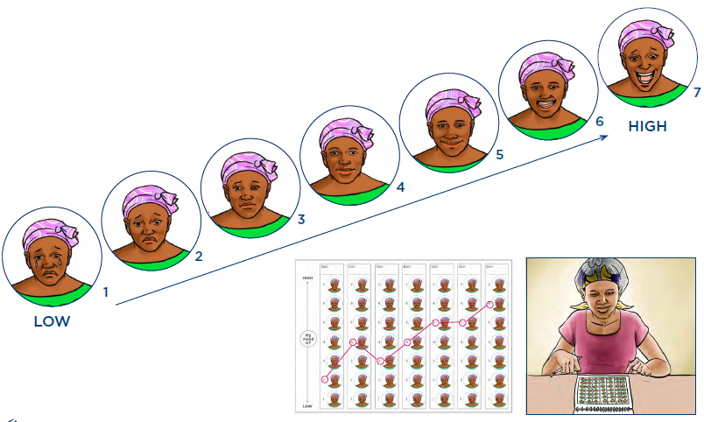
The Mood Scale: Self Awareness Tool

Slide 5
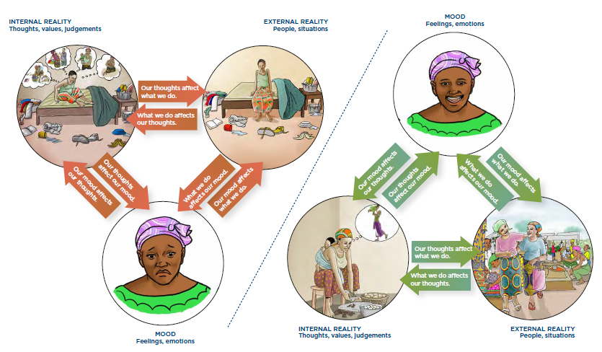
Integrated Mothers & Babies Course (I-MBC) in Brief

Slide 6
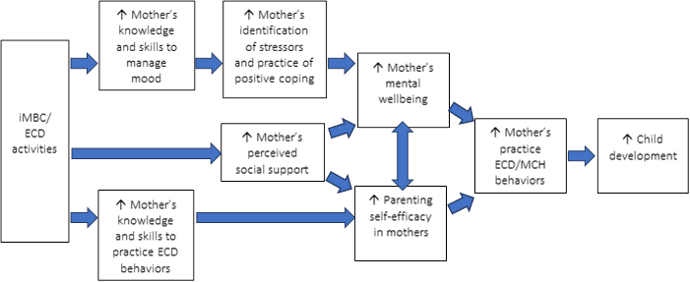
IMBC/ECD Model Theory of Change

Slide 7
I-MBC Operation Research: Difference in Difference (DID) Design
G
Outcome Measure
B
Treated group 1 (ECD + IMBC)
Impact 2 = (G-B) – (H-D)
Program/Intervention Group
Impact 1 = (B-A) – (D-C)
F
E
Treated group 2 (ECD only)
A
Assumed Parallel
H
D
Impact at 2020 for Treatment 1 = (G-B) – (H-D)
Impact at 2020 for Treatment 2 = (F-E) – (H-D)
Comparison Group
Comparison group (No Intervention)
C
Baseline
(Mid - 2017)
Follow-up Survey 1 (February 2019)
Follow-up Survey 2
(August 2020)
Time

