Slide 1
It Takes Community Health Workers
to End
Violence against Children
Tom Davis, MPH
Global Sector Lead, Health & Nutrition
World Vision International
CORE Group Practitioner Conference
October 15, 2019
Notes:
The last few years have seen increased buy-in from the global health community on the health sector’s role in ending violence against children.

Slide 2
Understanding Community Health Workers’ perceptions and practices to end violence against children
Why this survey?
A survey of 412 CHWs
In 4 countries: Bangladesh, Kenya, Myanmar and Tanzania
Notes:
This year, we undertook a new study for several reasons:
World Vision is running a global campaign to end violence against children, now active in 75 countries. It calls for every individual, every organisation and every sector to play its role – and we believe that the health sector in particular can play a pivotal role.
Violence against children is often a hidden phenomenon, and difficult to detect.
There is increasing political will and recognition of the health sector’s role overall in this, and some evidence exists on the role that CHWs and other lay workers have in preventing violence against children, particularly through providing support to parents and caregivers. However, there is little evidence on CHWs’ current role in detecting and responding to violence against children. Further evidence is needed on the potential of paid and volunteer CHWs in ending violence against children. .
Often, CHWs are the first or only health care workers that children may see, particularly in resource-poor contexts, and this potentially positions CHWs as the front line of the health sector in preventing, detecting and responding to violence against children. There have been concerns in the past about the risks involved in mobilizing CHWs around issues of ending violence against children which may be culturally sensitive, despite the fact that CHWs are already intervening in other sensitive areas, like family planning. There are also considerations related to the benefits and drawbacks of adding tasks to the CHW’s duties.
As I mentioned earlier, our results are based on a survey of 412 CHWs in Bangladesh, Kenya, Myanmar and Tanzania.

Slide 3
What did we want to know?
CHWs’ current perceptions of the prevalence of violence against children (VAC) & their responses to it.
CHWs’ perceptions of their current ability to prevent, detect and respond to VAC, the support they receive, and any perceived barriers.
Make recommendations to inform the design and implementation of interventions to end VAC
Notes:
There were three main things that we wanted to do through this study:
Learn about CHWs’ current perceptions of the prevalence of violence against children in their community & their responses to it.
Learn about CHWs’ perceptions of their current ability to prevent, detect and respond to violence against children, the support they receive and need and any perceived barriers.
And then to use that information to make recommendations to inform the design and implementation of interventions to end violence against children by governments, World Vision and partners.

Slide 4
76% of CHWs reported observing any form of violence against children during the course of their work
Over 74% of CHWs in the four countries studied perceived all forms of violence against children to be very serious.
Notes:
And here are the main things that we found in this study:
76% of CHWs reported observing any form of violence against children during the course of their work. This is a key finding and shows that CHWs are well-placed to observe what is happening with chidren, despite it sometimes being a more hidden behaviour.
And over 74% of CHWs in the four countries studied perceived all forms of violence against children to be very serious.

Slide 5
1. Frequency with which CHWs witnessed VAC, last 3 months, by type
Notes:
Community health workers in the four countries witness violence against children at a very high rate through their work, which helps confirm the existing country-level data about the prevalence of different forms of violence.
Child marriage, harsh physical discipline and verbal abuse stand out as major issues across all four countries, with Child marriage affecting mainly girls, and the other two issues mainly effecting boys.
Note: Community health workers also witness a very high number of children without proper nutrition, clothing, health and care and who are not attending school. While the survey has lumped these deprivations as ‘neglect’, the survey did not determine whether parents and caregivers has the necessary resources and capacities to provide for the children (as per the official definition of neglect).

Slide 6
Other findings:
CHWs mostly believed it was already part of their role to prevent and respond to VAC.
Over 60% reported taking action after witnessing abuse.
CHWs were highly motivated to receive training on VAC related issues, but only 23% reported receiving VAC-related training in the last 12 months.
Only 16% of CHWs identified existing Child Protection Groups (CPGs) in their communities
Notes:
We found that CHWs mostly believed it was already part of their role to prevent and respond to VAC, particularly in terms of counselling, prevention and referrals, and display significant confidence levels about their existing abilities in this area.
And over 60% reported taking action after witnessing abuse. (For whatever reason, Kenya’s CHWs were overall more likely to respond to all forms of abuse, and CHWs from Bangladesh and Myanmar were less likely to respond.)
CHWs were highly motivated to receive training on VAC-related issues, but only 23% reported receiving VAC-related training in the last 12 months.
But we need better support systems for CHWs since only 16% of CHWs identified existing Child Protection Groups (CPGs) in their communities. This is important since responding to violence carries its own risks, and CHWs should have community support when they respond and refer.

Slide 7
2. CHWs’ actions to end violence against children (last 3m)
Types of actions
Notes:
CHW’s violence-related work appears all the more remarkable considering that it is not included in their formal duties and some of their barriers which I will mention in a minute.
There is a clear potential to more intentionally consider the role of CHWs in counselling for positive parenting – this graph shows how they are responding, and note that counselling on positive parenting was their most common current response. More research is needed to understand exactly what type of counselling from health workers in different circumstances could make the highest impact on violence and how to measure that.

Slide 8
3. CHWs’ perception of Who Approves/ Disapproves of their VAC prev/response work
Notes:
Three stakeholder types were more commonly cited as being the most influential – both positively and negatively – in terms of a CHWs’ involvement in prevention and response work on VAC: Community leaders, government workers, and parents of children. Not that there are higher percentages of CHWs who mentioned people who do support or would support CHW involvement in VAC prevention and response than the percentages who would disapprove of that.

Slide 9
3. CHWs’ perceived barriers to address violence against children in their work
lack of training (56%)
lack of community support (38%)
lack of personal motivation (32%)
inadequate transport (30%)
possible non-cooperation of victims or families (22%)
personal security (13%)
Notes:
In terms of overall barriers, we found that:
56% mentioned lack of training
38% mentioned lack of community support
32% mentioned lack of personal motivation
30% mentioned inadequate transport
22% mentioned possible non-cooperation of victims or families, and
13% mentioned lack of personal security as a barrier.
Any future interventions geared to strengthen the role of CHWs in ending VACwill have to carefully consider how to lower these barriers, and “influence the influencers” as they can make it harder or easier for CHWs to intervene in this area.
Some of these may be easily overcome by targeted investments of governments, NGOs and partners -- like lack of training and inadequate transport. But it will be essential to generate community support by community leaders, faith leaders, government workers and parents so that CHWs can safely and optimally engage in violence prevention and response.

Slide 10
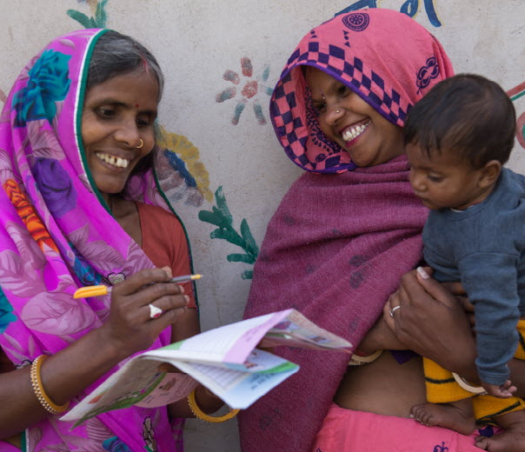
Conclusions
CHWs are detecting hidden violence, perceive it as very serious. CHWs can help with data collection
CHWs are already responding to violence – and could do more with training & supervisory support
CHWs’ work to end violence against children needs to be linked with c-b child protection structures that include CHWs
Support by community leaders, gov’t workers, parents & faith leaders can be a key enabler for CHW’s safe engagement in ending violence
Notes:
Our main conclusions from this research are:
CHWs are already detecting hidden violence, and they can assist with data collection on VAC.
CHWs are already responding to violence – they could do more with proper training & supervisory support
CHWs’ work to end violence against children needs to be linked with community-based child protection structures that include CHWs
Support by community leaders, government workers, parents & faith leaders can be a key enabler for CHW’s safe engagement in ending violence.

Slide 11
Next Steps:
Publishing a series of papers.
Hosting a series of technical roundtables/discussions with partners externally (e.g., CORE Group, WHO, the Global Partnership to End Violence) to inform policy and programmatic choices by WV, other organisations and governments.
Notes:
Our next steps include:
Publishing a series of papers in the coming months. We also have a summary of our research report available.
We will be hosting a series of technical roundtables and discussions with partners externally, including this one today, but also WHO , and the Global Partnership to End Violence, in order to inform policy and programmatic choices by World Vision and other organisations and governments.

