Slide 1
.
UNIVERSAL HEALTH COVERAGE; PROGRESS THROUGH ADOLESCENT-RESPONSIVE HEALTH SYSTEMS.
2019
REGIONAL GLOBAL HEALTH
PRACTITIONER CONFERENCE
Apio Winfred-Programme Mgr Sexual Reproductive Health and Rights and gender equality

Slide 2
More than 3000 adolescents die everyday from largely preventable causes, according to, a 2015 report from WHO . The Global Accelerated Action for the Health of Adolescents (AA-HA!). The AA-HA! Provides guidance to support country implementation on what to do as well as how to do it- as they respond to health needs of adolescents in their countries.

Slide 3
AA-HA!; guidance to support country implementation
Adolescents are not simply old children or young adults.
This deceptively simple observation lies at the heart of WHO’s 2015, AA-HA!; guidance to support country implementation – which reflects the coming of age of adolescent health within global public health and Universal Health Coverage.

Slide 4
Adolescents in the UHC
Around 1.2 billion people, or 1 in 6 of the world’s population, are adolescents aged 10 to 19.
In Uganda adolescents account for more than half of the population (56%) below 19 years.
Most are healthy, but there is still substantial premature death, illness/diseases, and injury among adolescents.

Slide 5
Main Health issues affecting adolescents
1 in 4 Ugandan girls age 15-19 are is already mothers or pregnant with their first child.
According to Uganda’s RMNCAH sharpened plan almost 28% of maternal deaths in Uganda occur in young women aged 15 – 24 years
Diarrhea, lower respiratory tract infections and meningitis are among the 10 causes of deaths for 10 to 19 years old in LDCs
Mental health:
Violence
Alcohol and drugs:
Injuries:
Malnutrition and obesity:
Lack of exercises:
Risks to STDs and HIV

Slide 6
Understanding the concept of Universal Health coverage - UHC
Affordability
Financial Protection
Accessibility
Equity
UHC means, “Every person, everywhere, has access to quality health care without suffering financial hardship.
Who: All people including the poorest and most vulnerable
What: full range of essential services, of good quality
How: reducing out of pocket expenses through cost sharing (pre-payment and risk pooling)
High Quality People – Centered & Integrated interventions
Quality
Acceptability
Services
Availability

Slide 7
Universal Health Coverage – Delivering a responsive health care system for adolescents and young people.
Today, universal health coverage (UHC) provides an opportunity for renewed attention to meeting the health-care needs of adolescents through the strengthening of health systems.

Slide 8
Accelerating action for the Health of Adolescents!
The Global Strategy for Women’s, Children’s and Adolescents’ Health ( GSWCAH 2016–2030) and the AA-HA! Frameworks identify adolescents as being central to achieving the SDGs and UHC.
The rapid physical, cognitive and psychosocial growth and development that takes place between the ages of 10 and 19 years influences an individual for the rest of his or her life.

Slide 9
UHC an opportunity to deliver an adolescent responsive health system
Adolescents pose different challenges for the health-care system than children and adults, due to their rapidly evolving physical, intellectual and emotional development.
Progress toward universal health coverage requires a transition from adolescent-friendly projects to adolescent-responsive health systems.

Slide 10
How can we deliver adolescent heath respsonsive systems?
Through flexible service delivery platforms
Through service delivery quality and coverage
Through bringing services closer to adolescents
Addressing inequity in access and use
Developing an adolescent-competent workforce
Financing UHC for adolescents

Slide 11
1. Through service delivery platforms
Services geared for adolescents need to go beyond sexual and reproductive health to address the full range of adolescents’ health and development needs.

Slide 12
2. Through service delivery quality and coverage
To improve quality, some countries are adopting quality standards.

Slide 13
3. Bringing services closer to adolescents
There are a number of ways to expand coverage, including mainstream services, school health services, e-health and m-health.

Slide 14
4. Addressing inequity in access and use
Identifying adolescents who are not covered by existing services is important.

Slide 15
5. Developing an adolescent competent workforce
All health professionals should benefit from pre-service training with knowledge of adolescent health and development and their implications for clinical practice.

Slide 16
Financing UHC for adolescents
To advance universal coverage, consider pooled prepaid sources of funds to include priority services for all adolescents.

Slide 17
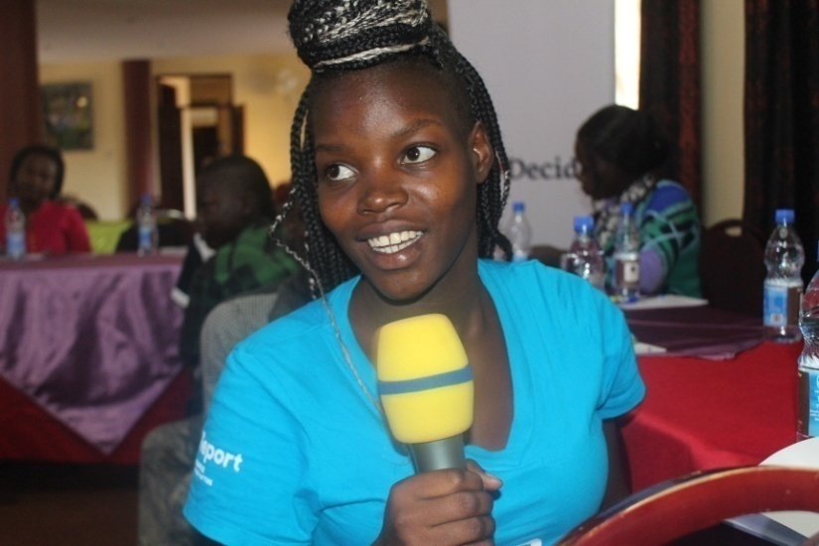
Universal health coverage: a new framework for action
UHC requires that appropriate and effective interventions for improving adolescent health and dev’t are available, and that policy-makers, health-care providers, adolescents and their parents know about these health services.

Slide 18
UHC Report On Young People’s Experiences, Needs And Challenges With Uganda’s Health Care System
https://uyahf.com/uhc-report-on-young-peoples-experiences-needs-and-challenges-with-ugandas-health-care-system/

